Slide 1
Security & Stability
in the Indo-Pacific
ADMM+ Experts’ Working Group
on Maritime Security
ADM Sam Paparo
Commander, U.S. Pacific Fleet

Slide 2
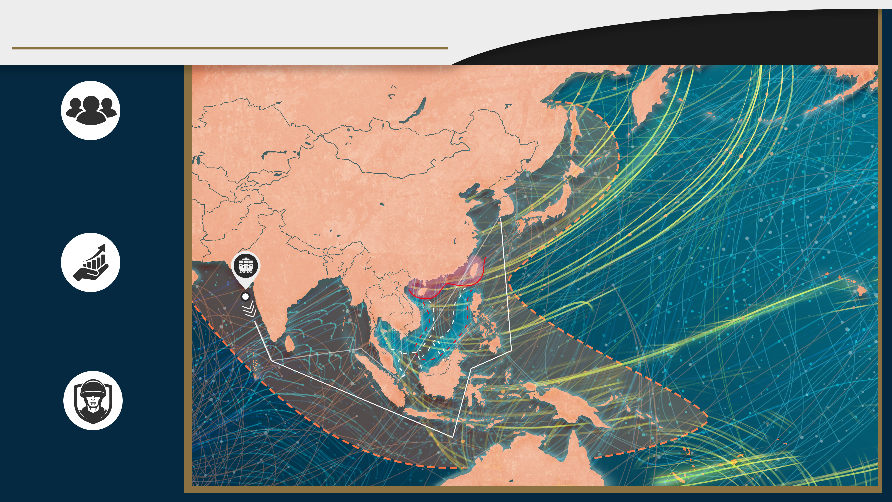
What is at Stake in the Indo-Pacific?
PEOPLE
More than half of the world’s population depends on fish for at least 20% of their animal protein and 20% of the global catch is IUU fishing – an unsustainable mismatch
ECONOMY
Shipping routes that avoid the SCS add 2.5 days / transit –
That difference multiplied by the 84,000 ship transits / yr = an additional 575 years!
Roughly $10 trillion in financial transactions travel via Indo-Pacific submarine cables each day
RESOURCES
The SCS holds about 190 trillion cubic feet of natural gas and 11 billion barrels of oil in proved and probable reserves
Reliable Access to the Trade & Resources We All Depend On
Notes:
Done - Add legend back
Done - $10 trillion
7 military icons

Slide 3
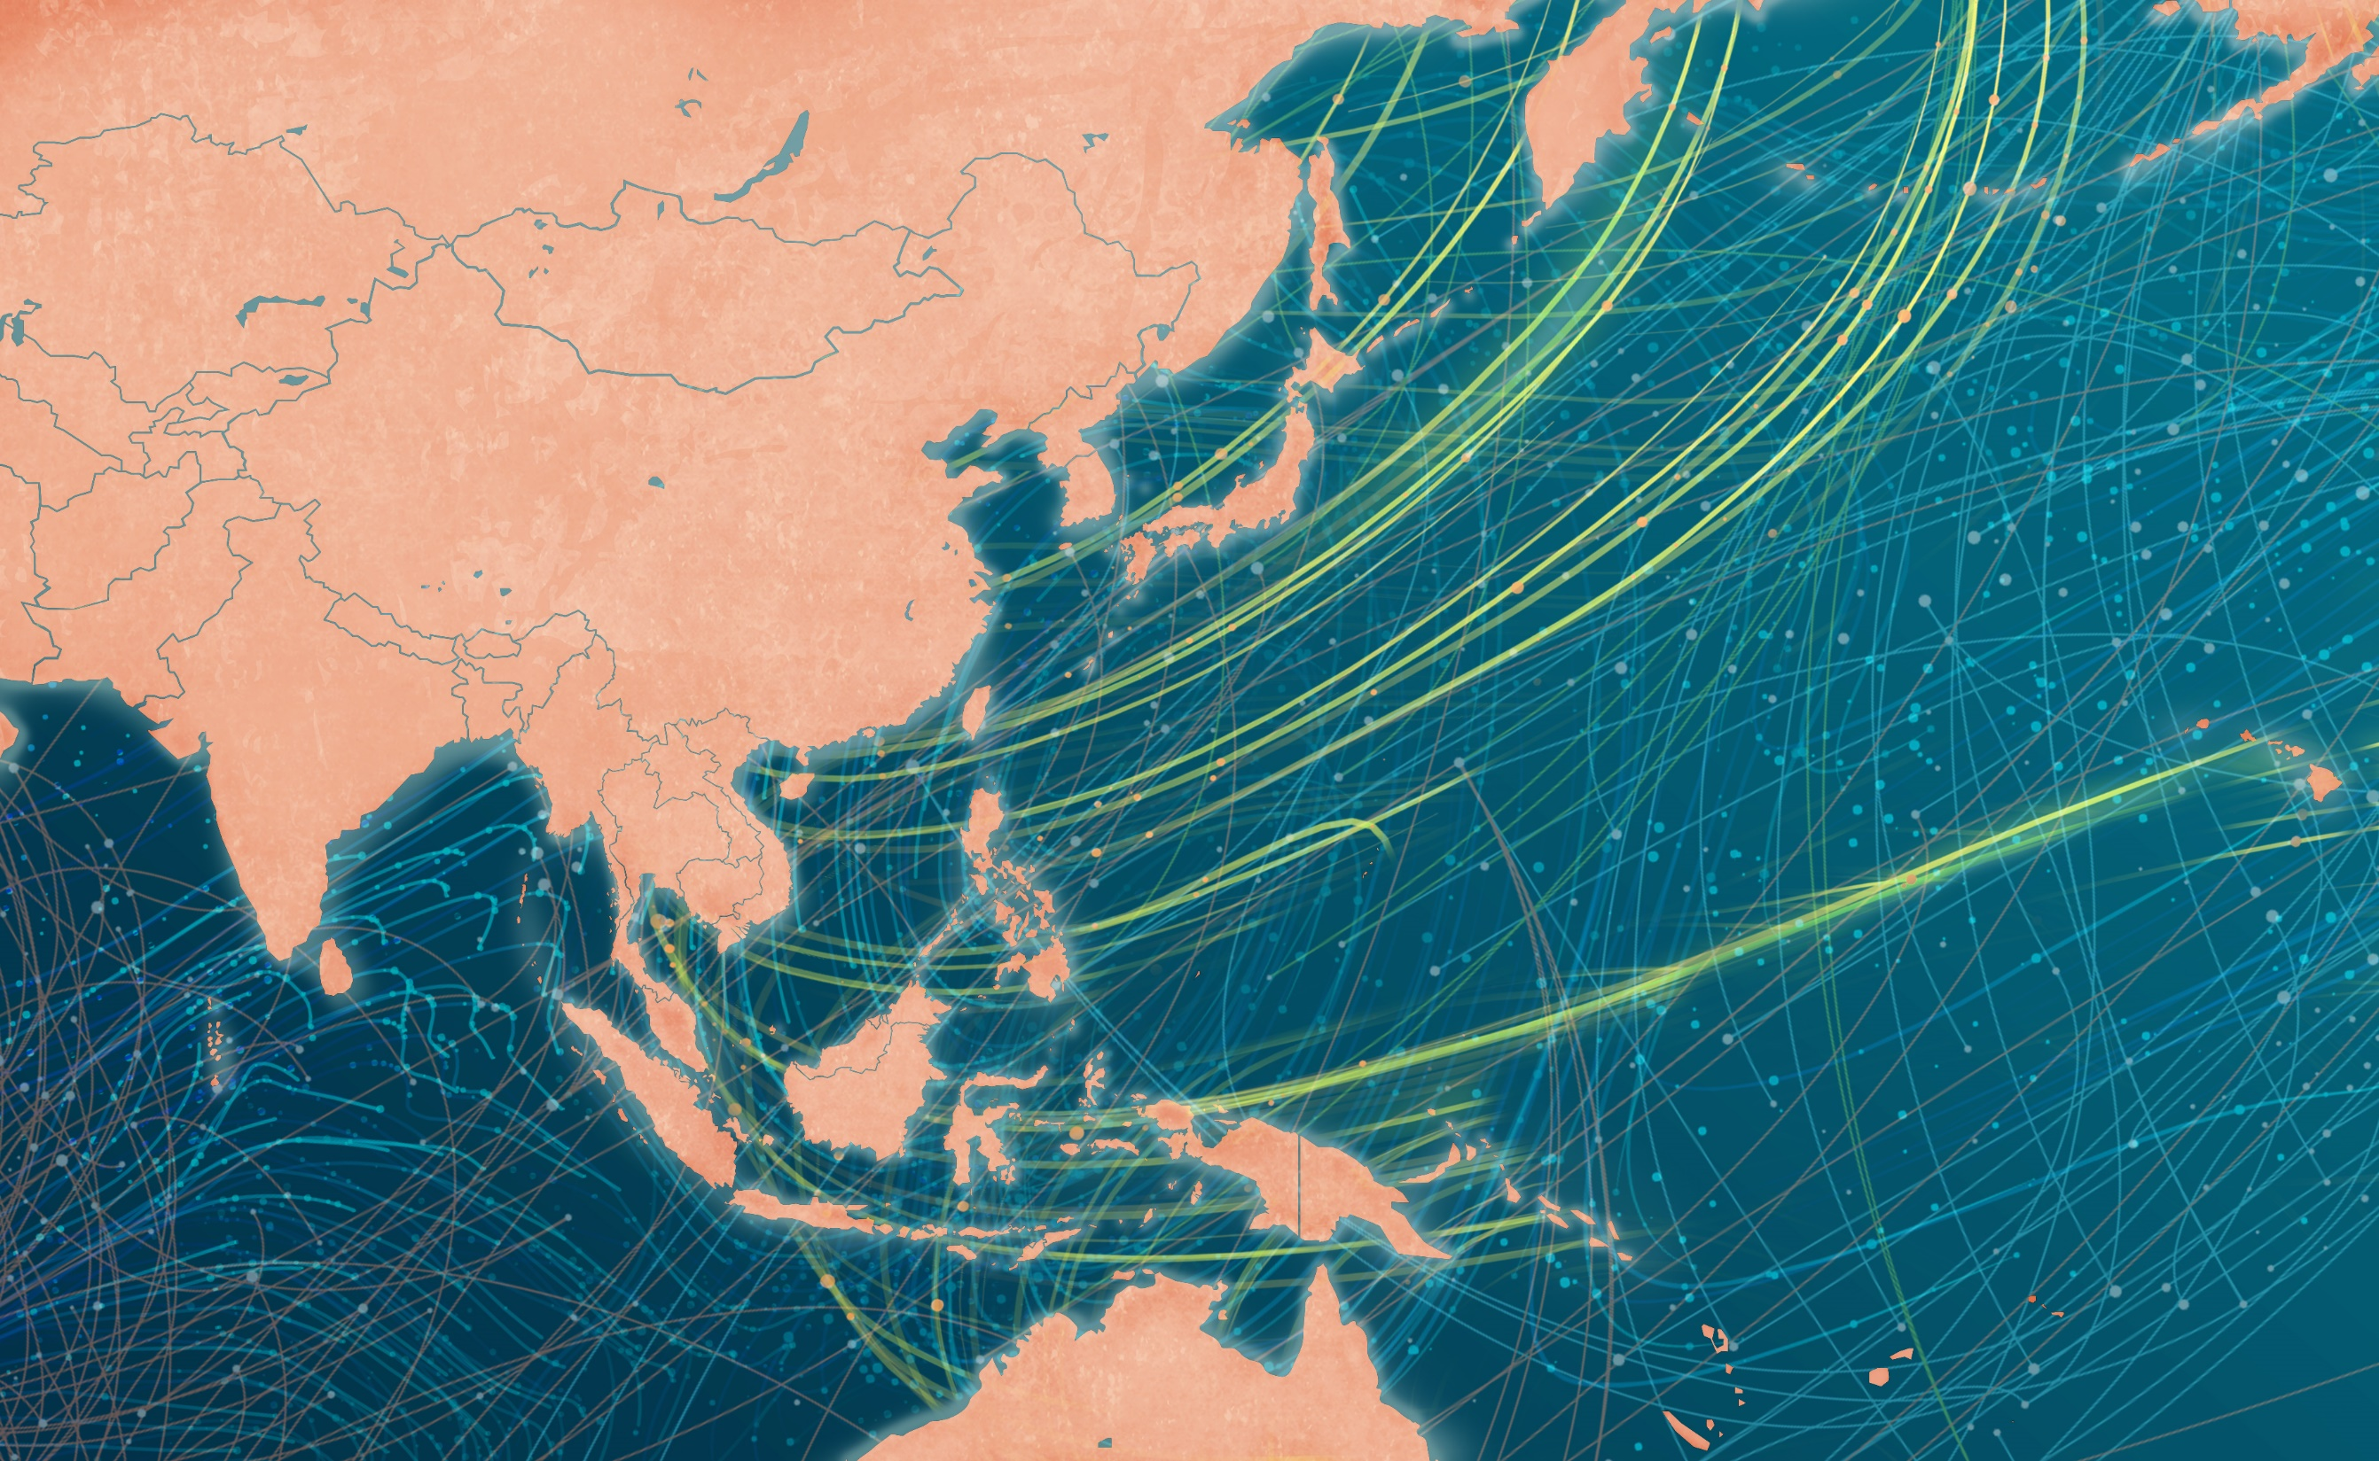
What is Threatening the Indo-Pacific?
PIRACY
41% of global incidents occur in Southeast Asian waters
IUU FISHING
25 million tons of fish are lost globally each year to IUU fishing activity
1/5 fish caught and sold illegally, worth an estimated $23.5 billion annually
UNCLOS
VIOLATIONS
China’s actions in the SCS directly undermine and are
at odds with the principle of freedom of navigation provided for in UNCLOS
CLIMATE CHANGE
Sea levels in the western Pacific Ocean are increasing at a rate
2-3 x the global average
90% of coral reefs in the Pacific Island region could suffer severe degradation
Increasing & Complicated Challenges with Long Term Impacts
Notes:
Unclos – in blue area
4 icons on left, 3 on map (piracy and IUU multiple),

Slide 4
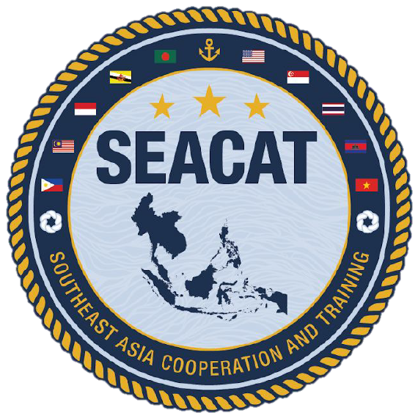
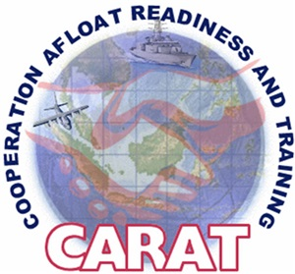
How Are We Responding?
INFO FUSION CENTERS
The ability to share open source information & make sense of real time conditions
SEACAT
Employing new technologies to improve Maritime Domain Awareness (MDA) and conduct multilateral intercepts
CARAT
Expanding scope and scale with multilateral and multi-agency partnerships
PACIFIC PARTNERSHIP
USNS MERCY developing connections across Southeast Asia and increasing capacity
Always Combined,
Multi-Lateral When Possible

Slide 5
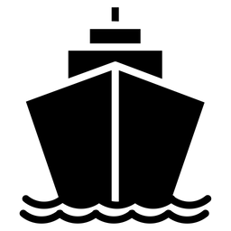
What Is the Way Ahead?
COOPERATIVE CAPACITY ENHANCEMENTS
Utapao airfield enhancements
Bengkulu tsunami shelter
Basa C2 Fusion Center
Zambales Amphib Staging Area
INCREASED EXERCISES
USCG Advisor assigned at the U.S. Mission to ASEAN
Increased USCG technical training to partner law enforcements agencies
NEW CAPABILITIES
Unclassified satellite radio frequency geo-location
Common Unmanned Aerial Systems (UAS) and Operational Frameworks
Netted Self-Powered Unmanned Surface Systems (Saildrone)
Enduring, Policy Level Efforts Could Make The Difference

Slide 6
Questions & Discussion

