Slide 1

Views on the PRC: Relations with the U.S., NESA Region Ties, and Trends
Jeffrey Payne
NESA
November 2021

Slide 2
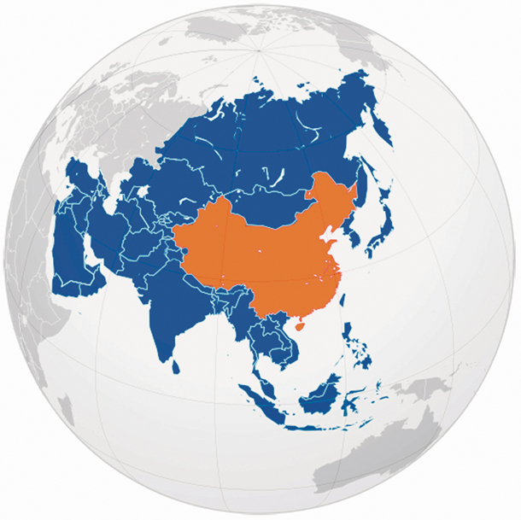
The People’s Republic of China/ ZhongGuo

Slide 3
The Basics
One Party State
  Chinese Communist Party
  Xin Jinping; President of the PRC, Chairman of the CMC, and General Secretary of the CCP
  Party/State apparatus with supremacy still retained by Party
Legitimacy of the CCP was once determined by adherence to Maoist doctrine; now on twin pillars of national cohesion and economic prosperity
PLA Serves the Party, not the State
Foreign Policy retains adherence to Maoist-era principles of non-intervention
  Yet, China’s diplomacy emphasizes economic relationships and greater willingness to actively steer, if not lead, international/multilateral institutions
  Bilateral engagement outside specific topics remains de facto preference
Economic model remains a mixed socialist market economy (Socialism with Chinese Characteristics)
  Success at domestic poverty alleviation, consumer market growth, and high-tech achievement
  Remains burdened by SOEs, opaque banking/lending institutions, economic regional distribution
Like all Nation-States, the PRC uses historical perception to define national aims:
  Late Qing era remains relevant politically (19th Century – 1911)
    Includes the Century of Shame
  Founding of the Republic (1911)
    Sun Yat-Sen; Warlord Era
  Second Sino-Japanese War, or WWII (1937-1945)
    Division of polity between CCP and ROC
  Chinese Civil War (1945-1949)
  Founding of the PRC (1949)
  Maoist Era (1949 – 1976)
    Great Leap Forward; Hundred Flowers; Cultural Revolution
  Reformist Era (1978 – 1991)
    Also called the Dengist era after Deng Xiaoping; Tiananmen Protests
  Technocrat Era (1991 – 2012)
    Jiang Zemin through Hu Jintao
  Xi Era (2013 - )
  Current narrative centers on continuing the reformist economic agenda enacted by Deng and promotion of national strength to overcome legacy of 19th and early 20th centuries.

Slide 4
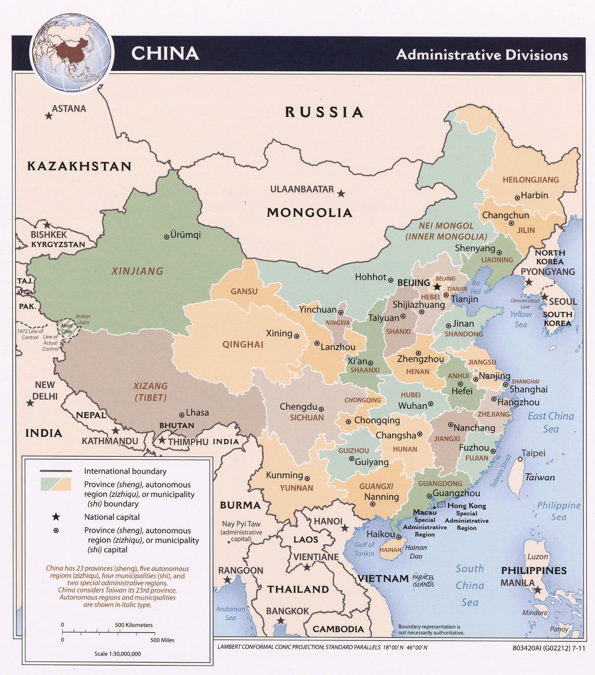
Internal Cohesion and
Border Concerns
Internal:
Xinjiang
Tibet
HK
External:
Korean Peninsula
ECS
SCS
Mekong Delta
India/China Border Region
Overlapping:
Taiwan/Taiwan Strait

Slide 5
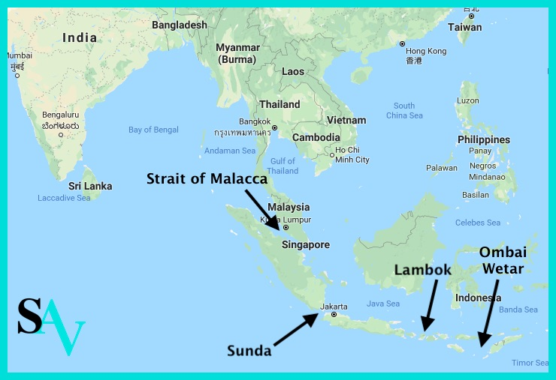
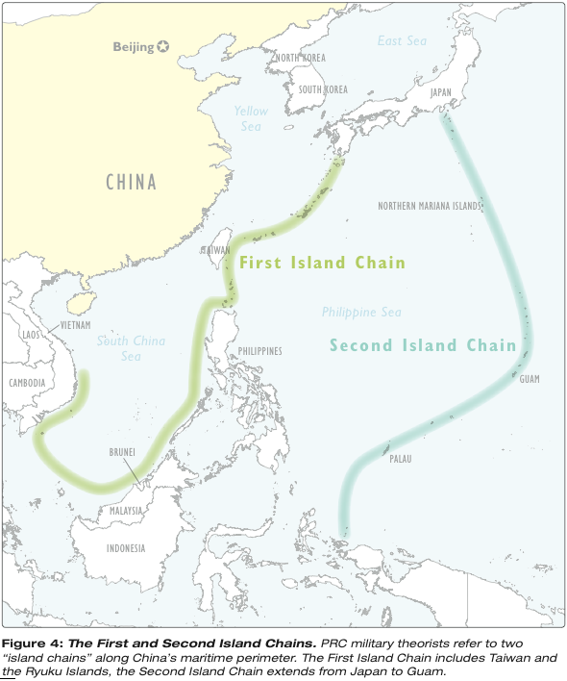
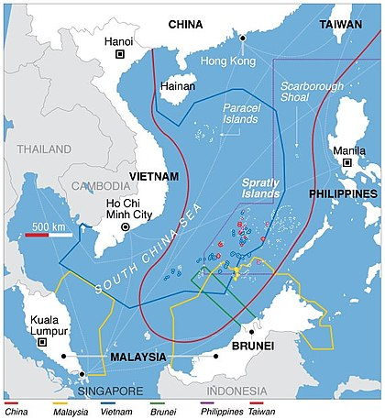
SCS, IOR Straits, and Island
Chains – Geography

Slide 6
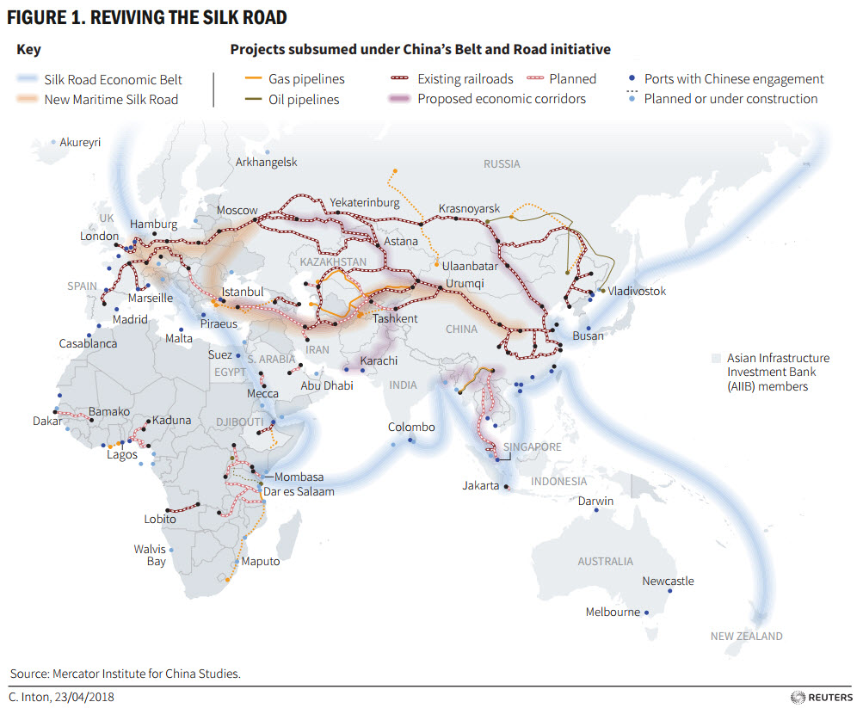
China’s Adventurous Foreign Policy
The BRI (Yidai Yilu)
  Built upon existing efforts
  SREB and MSRI
  Energy Needs/Export Necessity
Island Building, Salami Slicing, Gray Zone Efforts
  SCS – Spratly and Paracel
  Scarborough Shoal
  Chinese Maritime Militia
Overseas Logistics and Basing
  Development of Dual-Use Facilities
  Logistical Advancement for Overseas Deployments
  Djibouti Base
Bang the Drum
  China’s effective communication strategy
  Speed of action
  Figure out the limits (Covid-era, Wolf Warriors)
Gain Familiarity beyond East Asia
  Build relationships in regions where a relatively new player
  Gain SME expertise on non-East Asia regions

Slide 7
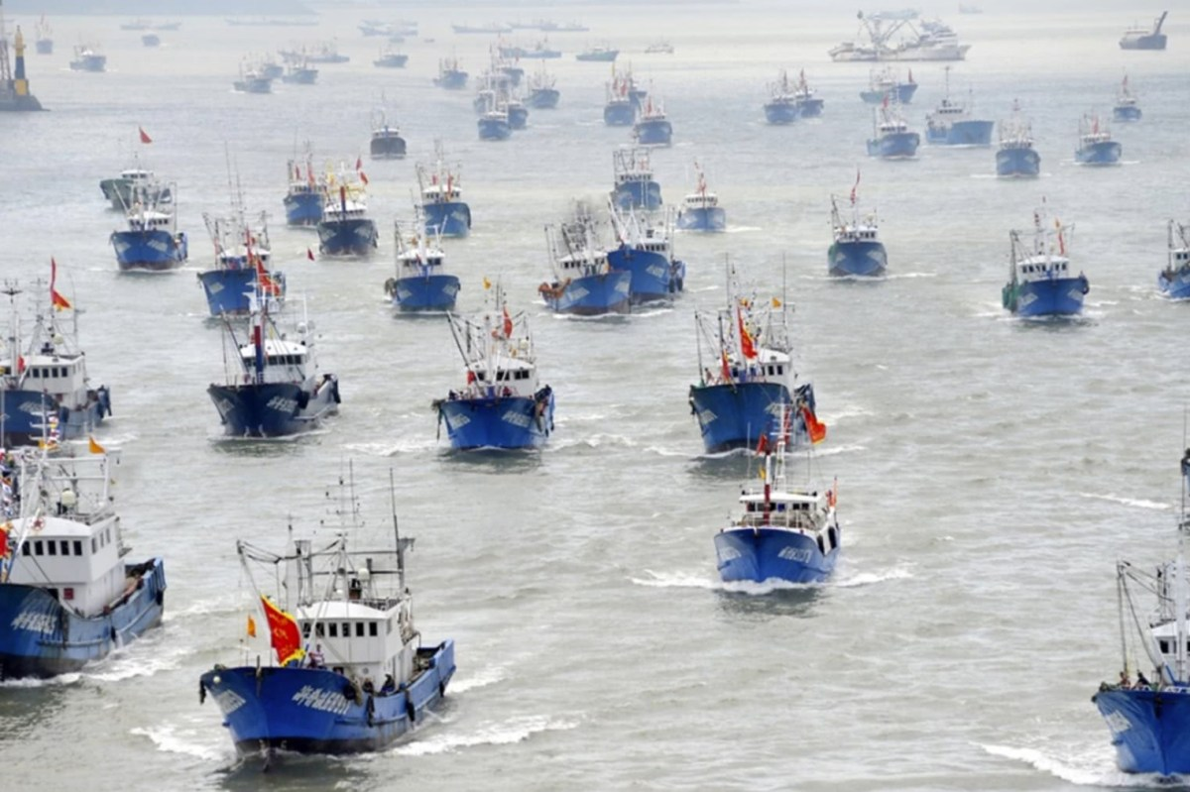
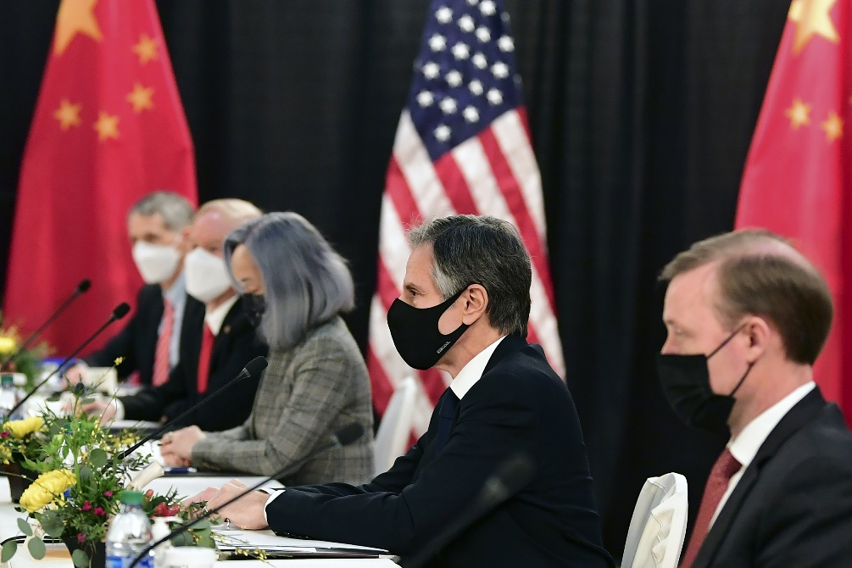
Larger Environment: U.S.-China Competition
The Free and Open Indo-Pacific; Rules and Norms
Western Pacific
Digital Systems
Legal Frameworks and State of International Institutions
Use of Information and Political Communications
Political Perceptions of Beijing and Washington
Response/Reaction of World

Slide 8
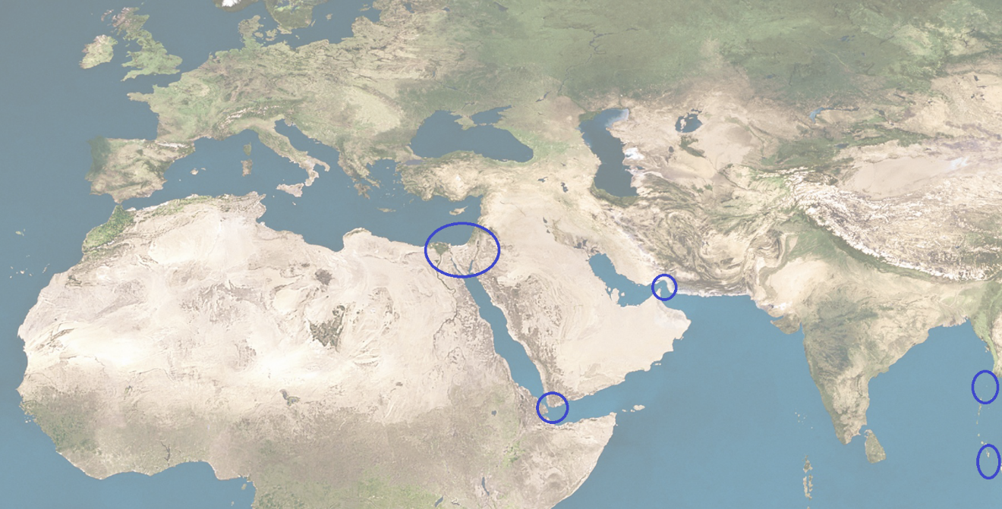







The PRC in the NESA Region
SUEZ REGION / EASTERN MEDITERRANEAN
STRAIT OF HORMUZ
RED SEA
ARABIAN SEA
ANDAMAN AND NICOBAR ISLANDS
BAB EL MANDEB / HORN OF AFRICA
WHY DOES THE REGION MATTER FOR CHINA?
MENA Region is becoming more to China than just a resource cache
MSRI over SREB (IOR becoming more central than Eurasia overland)
Bab al-Mandab and Arabian Sea remains key region for PLA/security efforts
Political standing starting to take shape vis-à-vis PRC in the region
Economic
Presence
POL/SEC
Presence
MSRI

Slide 9



China Security Presence in the Wider Middle East
Djibouti Base:
Dual Use Facility
PLAN resupply
PKO deploy point
Intelligence
Supports Djibouti Port investment
Political message of China overseas capability
CASE: Iraq
Maturation of relationship led to greater familiarity with Iraqi politics
Transition from small footprint in northern regions to larger efforts in southern regions
Energy and Infrastructure-centered economic diplomacy
Example of how the MSRI is emerging as key component of BRI
A
P
A
A
A
A
A
MIL Ops/Exercises:
2019: Iran/PRC/RUS in Gulf of Oman/Arabian Sea
Since 2008: PLAN Horn Patrol Missions
CASE: the Internal Debate
Increasingly common for analysts in China to recognize end date for “regional balance”
Debate over sides/choices
Future security sector action will be tied to littoral spaces, not overland
P
Add’ Security Presence
Arms Sales
Pvt Mil Contracts
PKO
PLA/PAP Delegations
Soft Security Approach
P
Base =
Ops/Exercises =
Add’ Security Presence =

Slide 10
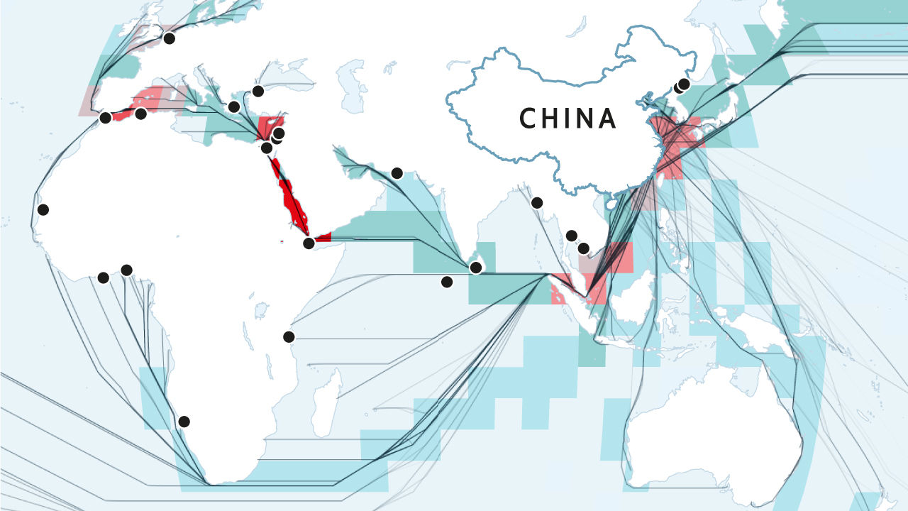
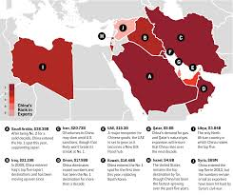
What China is and is not doing in the NESA Region?
China maintains Balancing Act; Recognizes termination date of that approach
China’s Maritime Interests don’t Raise too many Alarms; Make Logistical Sense; SREB can’t work
Economic Diplomacy still drives relationships, but overt political pressure and messaging becoming increasingly common
Exploits Pricing and State-Driven Economic Model to advantage
China wants stability, but instability has provided immense opportunity for Beijing
What should the NESA Region Consider on the Horizon?:
  How competition between major powers will play out in the wider Indian Ocean Region – it will become a/the major competitive area. China becoming a maritime, not continental power.
  What will it mean for regional states as China becomes more entangled in regional politics?
  What happens when the pace of China’s push slows?
  The emerging partnerships and institutions that shall emerge in reference to China’s global ambitions

Slide 11
Many Thanks and
Look Forward to Questions
Email: jeffrey.payne.civ@ndu.edu
Twitter: @JeffreyPayneFP

