Slide 1
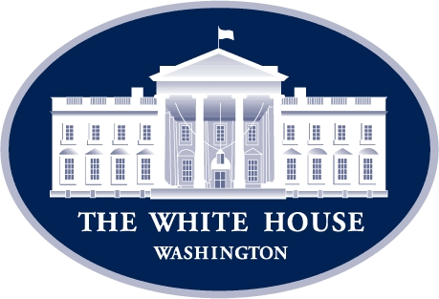
How Washington Works: Understanding the U.S. Government’s Power Centers Washington Embassy Orientation 18 October 2021
The views expressed are the author’s personal views and do not necessarily reflect official DoD policy.
Michael S. Bell, Ph.D.
Near East South Asia Center for Strategic Studies
Former Special Assistant to the President for National Security Affairs & Senior Director for Middle East Affairs,
National Security Council

Slide 2
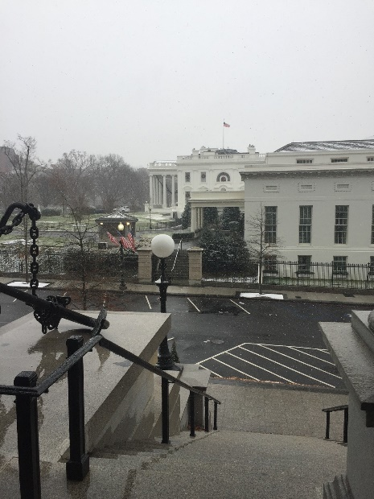
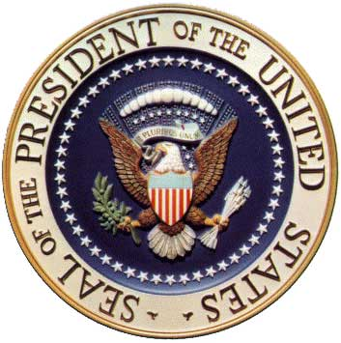
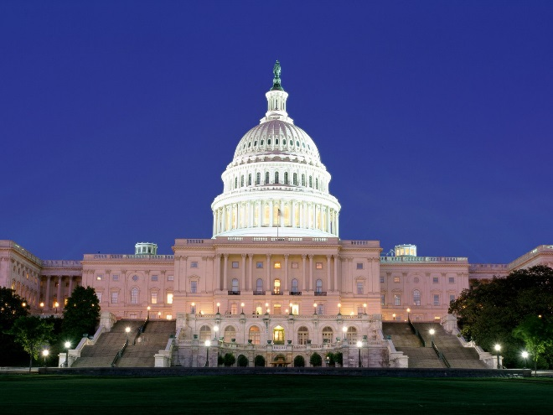
Who Defines U.S. Policy and Strategy?
The President and the National Security Council process
The Congress
Precedent and History
“Strategic Culture”

Slide 3
U.S. National Government
(117th Congress, 2021-2023)
HOUSE of
REPRESENTATIVES
(435 – 1 per 716,000
Constituency, elected
to 2-Year Terms)
SENATE
(100 – 2 per 50 states,
elected to 6-Year Terms)
THE PRESIDENT
VICE PRESIDENT
(Both Elected Nationally to 4-Year
Terms but Limited to Two Terms)
Executive Office
of the President
SUPREME COURT
LOWER COURTS
(Appointed for Life)
15 Departments
60+ Agencies and Gov’t. Corporations
3
Notes:
3

Slide 4
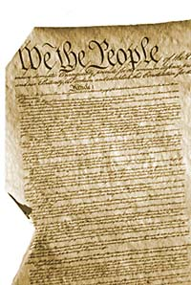
Article I: The Legislature
Two chambers:
House of Representatives
- proportional representation (approx 720,000 per district)
- 2-year terms
- 435 members
- All money (revenue) bills must
start in the House
Senate
- Two Senators per State (100 total)
- 6-year terms, 1/3 stand for election every two years
- “Advise and Consent” on Presidential appointments
- Historically more deliberative
- Vice President is the President of the Senate.

Slide 5
Article III: The Judiciary
The Supreme Court
Authority to interpret and apply the law
Power to rule legislative enactments or executive acts invalid on constitutional grounds
Discretionary jurisdiction. Doesn’t have to hear every appeal
Nine Justices, appointed by President, confirmed by Senate
U.S. / Federal Courts
Circuit Courts
District Courts

Slide 6
Article IV: Federal – State Relationships
“Full faith and credit” to the public acts, court proceedings, and records of other states
Sets rules for admitting new states and
Territories Today:
NATIONAL
STATE
50 STATE GOVERNMENTS
LOCAL
87,525 LOCAL GOVERNMENTS

Slide 7
Article II: The Executive
The President
Both Head of State and of Government
Commander-in-Chief of the military
Limited powers and authority
May sign or veto legislation from Congress
May make treaties, provided two-thirds of the Senate agree
Appoints Ambassadors, Supreme Court Justices, and other high public officials with the advice and consent of the Senate. Not much else (at least in the Constitution).

Slide 8
Presidential Powers: Specified
Treaty power
Negotiate treaties
Appointment power
Select people to serve in government
Ambassadors, justices, cabinet secretaries
Legislative power
Propose legislation; veto power
Other specific powers
Call Special Session of Congress
Grant pardons for federal crimes

Slide 9
Inherent Powers
Respond to crisis
Disasters, Civil War, Depression, 9/11
Commander-in-Chief of Armed Forces
Lead or deploy troops, including to combat
Conduct Foreign Policy
Make Executive Agreements
Declare neutrality
Executive privilege
Protect diplomatic and military secrets
Can be limited by legislation or declared unconstitutional by the Supreme Court

Slide 10
Delegated Powers
Congress has given power to the Executive Branch in domestic policy
Granted President authorities to respond to crisis—FDR, post-9/11 AUMF
Create new cabinet agencies and departments
Fixed responsibilities for Federal Government to address problems with welfare, education, environment, homeland security, etc.

Slide 11
Other Powers
Executive responsibility
Manage national affairs and the priorities of the government
Issue rules, regulations, and instructions (as Executive Orders)
U.S. Federal Budget
Political power
Leader of a political party
“Bully Pulpit”
Raise important issues to public

Slide 12
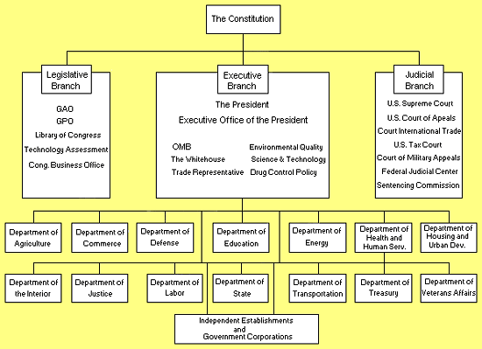
The Executive Branch
Integrate, Coordinate, and Employ ALL Elements of National Power
Diplomatic
Informational
Military
Economic
Financial
Intelligence
Law Enforcement
National Security Council Staff
Cong. Budget Office
Department of
Homeland Security
4

Slide 13
The Executive Branch
National Security Advisor
National Security Council Staff
Homeland Security Advisor
Cong. Budget Office
The Vice President
CJCS
Department of
Homeland Security
Director of National Intelligence
U.N. Ambassador
5
Dir CIA

Slide 14
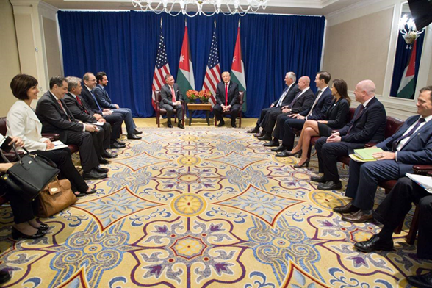
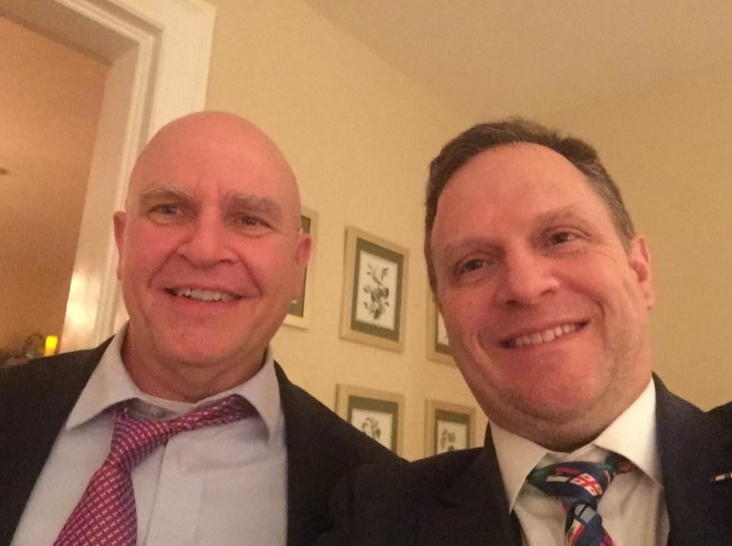
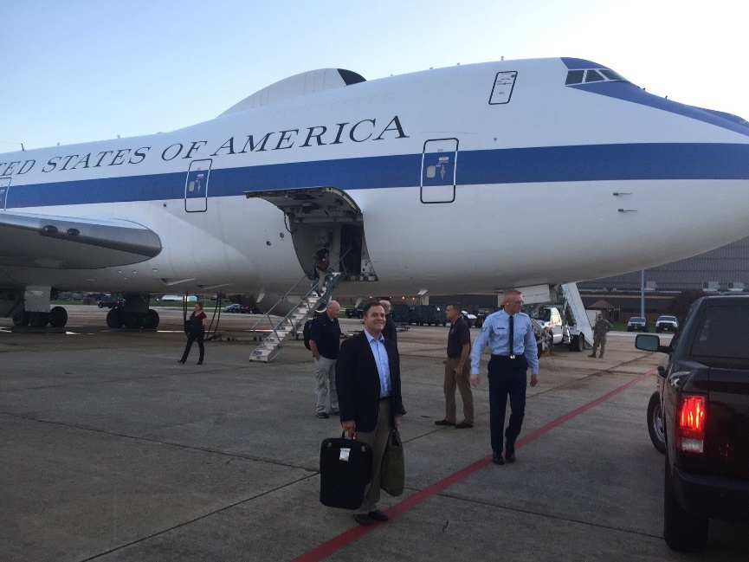
The National Security Council

Slide 15
The National Security Council
The National Security Council (NSC) shall be the principal forum for consideration of national security policy issues requiring Presidential determination. The functions, membership, and responsibilities of the NSC shall be as set forth in the National Security Act of 1947, as amended, and this National Security Memorandum.
The NSC shall advise and assist the President in integrating all aspects of national security policy. Along with its subordinate committees, the NSC shall be the President’s principal means for coordinating executive departments and agencies in the development and implementation of national security policy, and in long-term strategic planning.
President Joseph R. Biden, “Memorandum on Renewing the National Security Council System,” National Security Memorandum/NSM-2, 4 February 2021

Slide 16
The National Security Council System
NSC established in 1947 National Security Act; chaired by President with Secretaries of State and Defense, Army, Navy, Air Force, and Chairman National Security Resources Board
Updated by each Administration—and reflects different styles, approaches, and priorities.
Eisenhower formalized for strategic planning and to monitor and implement policies; informal under Kennedy and Johnson—staff atrophied
Nixon, Ford, and Kissinger—analytic body
Carter—National Security Advisor served as principal source of foreign affairs ideas (State Department operations coordinator and institutional memory)

Slide 17
The National Security Council System
In Reagan administration the NSC staff tended to emerge as a separate, contending party.
Under President George H.W. Bush:
Reorganized the NSC into a Principals Committee, Deputies Committee, and 8 Policy Coordinating Committees.
Restored collegiality.
The Clinton administration expanded NSC membership.
Included Secretary of the Treasury, U.S. Representative to the United Nations, newly-created Assistant to the President for Economic Policy (who was also head of a newly-created National Economic Council or NEC, parallel to the NSC), the White House Chief of Staff, and President's National Security Adviser.

Slide 18
The National Security Council System
Grown since 9/11 and with creation and incorporation of Homeland Security Council into the NSC staff
Most current directive: NSM-2, February 2, 2021
NSC – President chairs
Principals Committee – NSA chairs
Deputies Committee – Deputy NSA chairs
Interagency Policy Committees (previously Policy Coordinating Committees)

Slide 19
Elements of the System and Process
NSC
Congress, Judiciary, Public
Think Tanks, Lobbyists
POLICY
Principals
Departments
and Agencies
Deputies
Embassies
and
Deployed Forces
Interagency Policy
Committees
(IPC/PCC)
IMPLEMENTATION

Slide 20
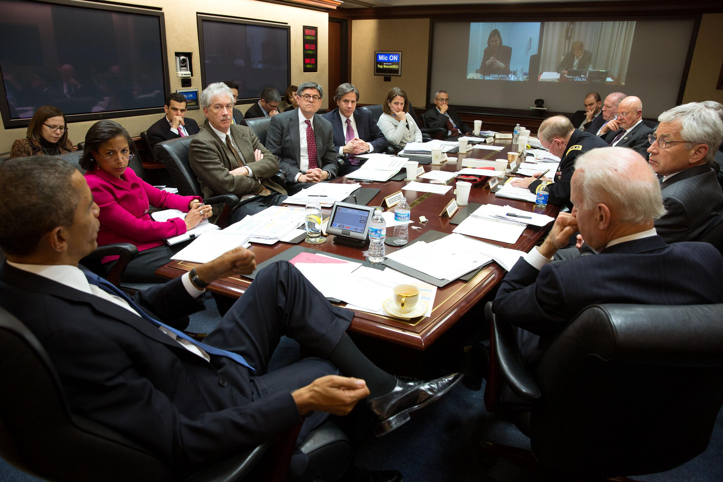
A National Security Council Meeting
March 3, 2014 (Official White House Photo by Pete Souza)
Secretary of Treasury
Political Counselor
Homeland
Security
Adviser
Asst SecState
(in Kiev)
Speech
Writer
UN Amb (in New York)
Deputy Secretary
Of State
Dep
NSA
National
Security
Adviser
Chairman
JCS
CIA
DNI
WH CoS
Secretary
of Defense
President
Vice
President
Discussing the Actions in Ukraine & Crimea

Slide 21
Trump Administration NSC
By Law Members:
President - chair
Vice President
Secretary of State
Secretary of Treasury
Secretary of Defense
Secretary of Energy
Per NSPM-4
April 4, 2017
By Law Advisors:
Director, National Intelligence
Chairman, Joint Chiefs of Staff
By Presidential Directive:
Attorney General (Justice)
Secretary Homeland Security
UN Ambassador
National Security Advisor
Homeland Security Advisor
Director, CIA
WH Chief of Staff
Counsel to President
“Invited Attendees”:
Deputy Counsel - NSA
Director, OMB

Slide 22
Biden Administration NSC
By Law Members:
President - chair
Vice President
Secretary of State
Secretary of Treasury
Secretary of Defense
Secretary of Energy
Per NSM-2
February 4, 2021
By Law Advisors:
Director, National Intelligence
Chairman, Joint Chiefs of Staff
By Presidential Directive:
Attorney General (Justice)
Secretary of Homeland Security
Representative to UN
White House Chief of Staff
National Security Advisor (Agenda)
Director, Ofc Science & Tech (OTSP)
Administrator, USAID
Director, CIA
Counsel to President
Deputy Counsel
“Invited Attendees”
Plus…
Deputy National Security Advisor (NSC Secretary)

Slide 23
Biden Administration NSC—Additional Regular Attendees
Due to cross-cutting nature of critical issues:
Secretary of Commerce
Secretary of Labor
Secretary of Health and Human Services
Administrator, Environmental Protection Agency (EPA)
Director, Office of Management and Budget (OMB)
US Trade Representative
National Cyber Director
Assistant to President for Economic Policy
Assistant to the President for Domestic Policy
Chairman, Council of Economic Advisors
Homeland Security Advisor
Deputy National Security Advisor for Cybersecurity
Deputy National Security Advisor for International Economics
COVID-19 Response Coordinator
Special Envoy for Climate
Per NSM-2
February 4, 2021

Slide 24
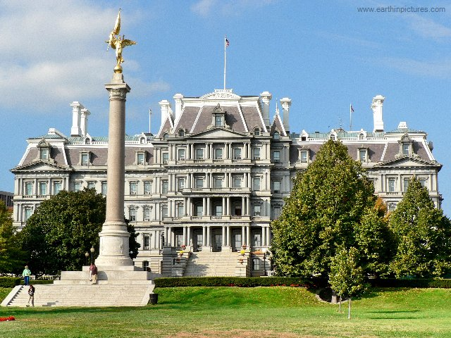
The National Security Council Staff or National Security Staff (NSS)
Approximately 300 persons, most in Eisenhower Executive Office Building (EEOB)—across the street from the White House West Wing
Statutorily headed by Executive Secretary / NSC Chief of Staff; but in practice report to the Assistant to the President National Security Advisor (APNSA) and to Homeland Security Advisor
Mix of:
“permanent” staff (about 30)
political appointees (varies, but probably about 75)
detailees from Departments and Agencies (200 – 225)
Regional and Functional Directorates
Three priorities (in order):
Staff the President
Staff the National Security Advisor and other senior White House officials)
Coordinate the Interagency (during crisis and deliberate policy processes) to include the development of integrated strategies

Slide 25
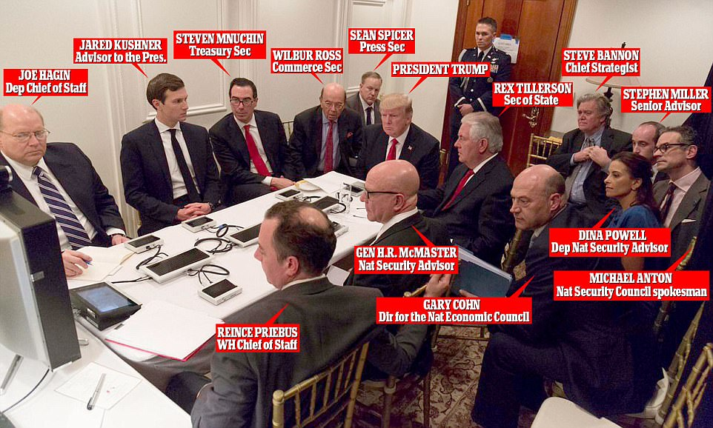
NSC Crisis Decision Making
Syrian Chemical Weapons Use

Slide 26
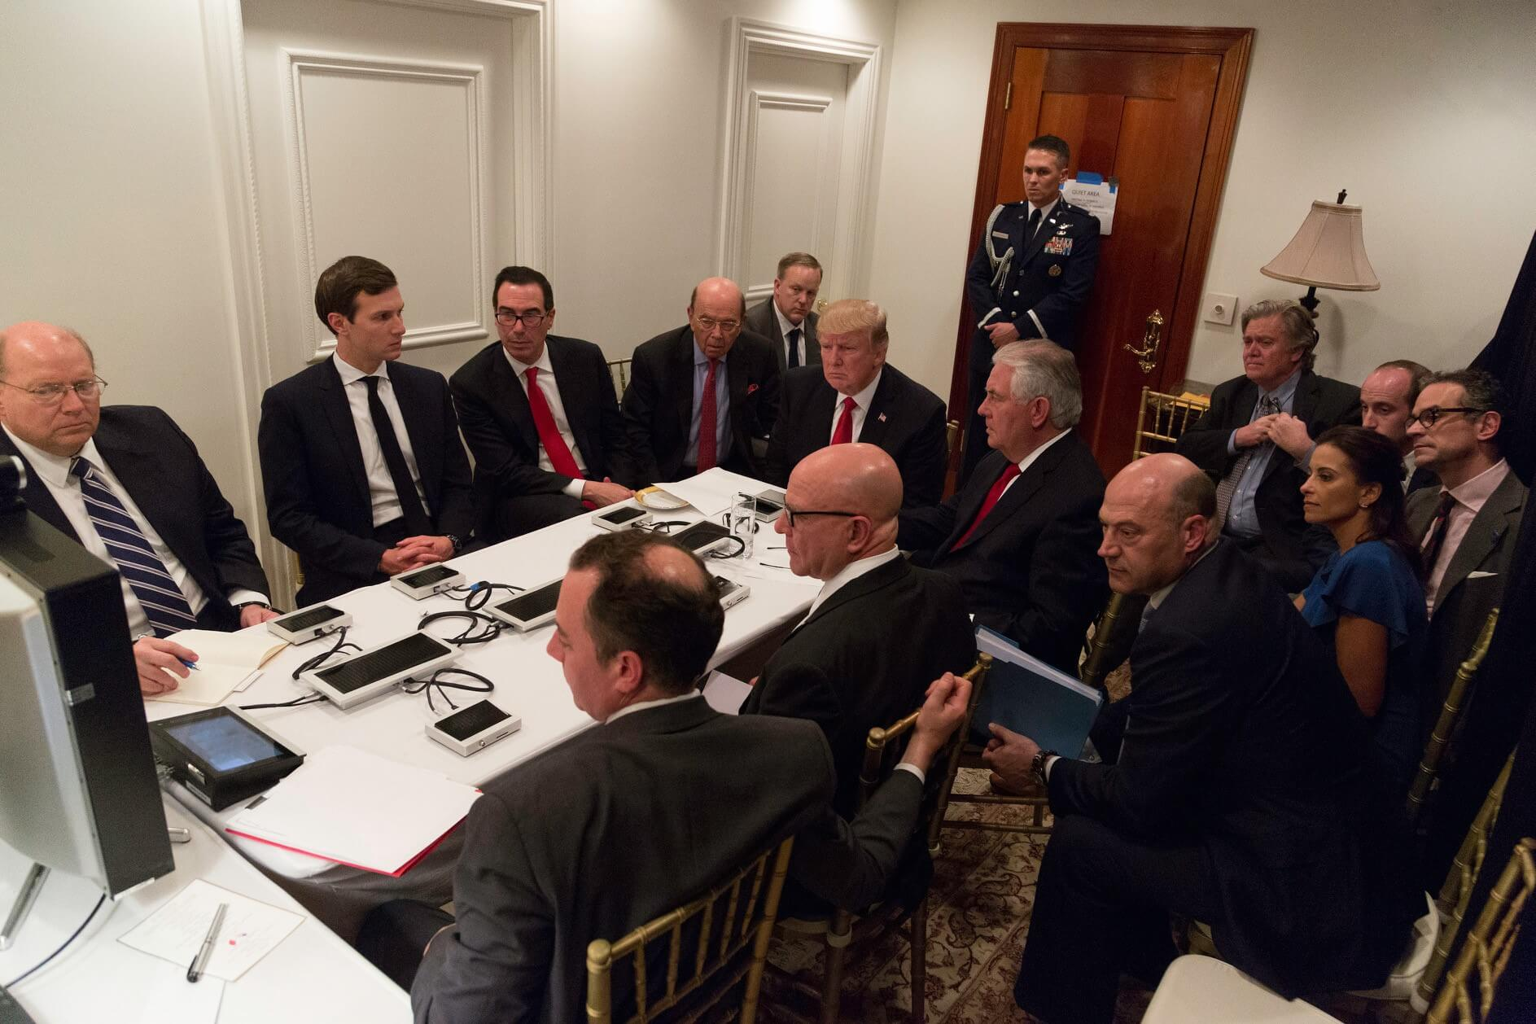
Elements of National Power
Diplomatic Power
Informational Power
Military Power
Economic Power
Financial Tools (including sanctions)
Intelligence and Covert Action
Legal and Law Enforcement
Responding to Syrian Regime Chemical Weapons use
Consider: There has been little variation in the understanding of national interests from 1990 until the present. Differences between various Administrations’ formulations of National Security Strategy can be attributed to personalities; resolving tensions between interests (and assumptions); which objectives and which element(s) of national power are given primacy; how threats and approaches are prioritized; and how much emphasis is given to strategy and strategic planning versus response.
26

Slide 27
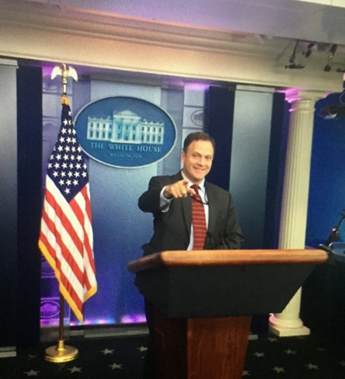
Questions

