Slide 1
Roadmap Development
Update
17th EWG on Maritime Security
23 August 2022

Slide 2
Topics
POA&M Update
Climate change definitions
Climate Change proposal
Marine Environment Protection proposal
New Maritime Navigation Safety proposal
Roadmap Workshop Prioritization
Summary
Questions and Comments

Slide 3
ADMM-Plus EWG on MS Roadmap Development
17th EWG MS
Tasks | 2021 |  |  |  |  |  |  |  |  |  | 2022 |  |  |  |  |  |  |  |  |  |  |  | 2023 |  |  |  |  |  |  |  |  |  |  |  | 2024
 | M | A | M | J | J | A | S | O | N | D | J | F | M | A | M | J | J | A | S | O | N | D | J | F | M | A | M | J | J | A | S | O | N | D | J | F | M | A | M | J
Draft Outline
Present Outline
Sections 1 & 2 Draft
Introduction
Security Environment
Draft Goals/End-States
Circulate
Present Sections 1&2
Finalize Sections 1&2
Guidelines Draft
Guideline 1
Guidelines 2-x
Circulate
Present Guideline Sections
Finalize First Draft
Review
Final Draft
Revisions
Final Edit
Delivery
15th EWG on MS (7/2)
16th EWG on MS (2/22)
17th EWG on MS (8/22)
18th EWG on MS (1Q)
19th EWG on MS (3Q)
20th EWG on MS (1Q)

Slide 4
Climate Change Definitions
Adaptation – Adjustment in natural or human systems in anticipation of or response to a changing environment in a way that effectively uses beneficial opportunities or reduces negative efforts.
Resilience – The ability to anticipate, prepare for, and adapt to changing conditions and withstand, respond to, and recover rapidly from disruptions.
Climate Change Mitigation – Measures to reduce the amount and speed of future climate change by reducing emissions of heat-trapping gases or removing carbon dioxide from the atmosphere.
Green Shipping Corridor – Maritime routes that showcase low- and zero-emissions across all aspects of the corridor in support of sector-wide decarbonization no later than 2050.

Slide 5
Climate Change

Slide 6
Marine Environment Protection

Slide 7
Maritime Navigation Safety (New Proposal)

Slide 8
Project Prioritization Polling

Slide 9
Climate Change Polling

Slide 10
Marine Environment Protection Polling

Slide 11
Summary and Way Ahead
18-20 July Workshop addressed concerns raised at 16th EWG on MS
Clear link to maritime security and EWG on MS role is necessary
Marine environment protection and climate change will be the issues addressed in the Roadmap
Next co-chairs have opportunity to review Indonesia and other proposals for consideration
For marine environment protection, the Roadmap will work on plan for cooperating and sharing information
For climate change, the Roadmap will work on plans for identifying and assessing effects, and integrating climate change considerations
Roadmap Team will work on drafting document
Future Roadmap groups to work on detailed plans of action

Slide 12
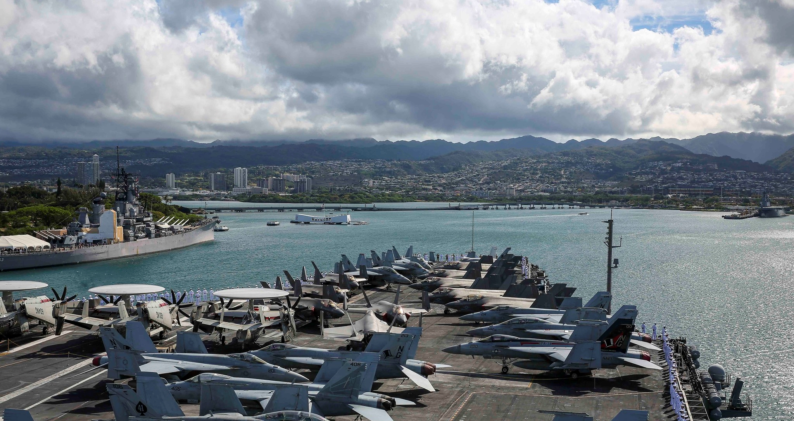
Questions and Comments

