Slide 1
The Growing Challenge Of Cybersecurity
Dr. Allen Badeau
Chief Technology Officer / SVP
Abadeau@nciinc.com

Slide 2
Biography: Dr. Allen Badeau
Dr. Allen Badeau is the Chief Technology Officer for NCI, as well as the director of the NCI Center for Rapid Engagement and AI Technology Exchange (CREATE) Lab. In this role, he leads innovation research and development activities designed to add value to NCI’s customers and their missions, including cutting-edge technologies such as artificial intelligence, cybersecurity, quantum computing, software defined networks, robotics, advanced data analytics, agile DevSecOps and many other areas. Prior to joining NCI, Allen held various leadership roles at ASRC Federal, CSC, Innovative Management & Technology Services and Lockheed Martin. Allen received his bachelor’s in physics, and both his master’s and doctoral degrees in mechanical engineering from West Virginia University and is a certified ethical hacker.
With the CREATE Lab, NCI is building next-generation, value-based solutions for its customers utilizing a collaborative, knowledge-sharing environment. Under Allen’s direction, the CREATE ecosystem brings together people, processes, and ideas, as well as software and hardware resources — exploring the strategy and implementation of new and advanced technologies, and redefining how innovation is integrated into our customers’ environment.

Slide 3
Agenda – Thursday, December 9th, 2021
The Rising Threat
The Response
The Example
Q/A
Backup – Tactical Pattern and/or Anomaly Recognition Searches (Several to take home)

Slide 4
THE RISING THREAT

Slide 5
Actors at Various Levels
Nation State Sponsored
Organized Crime, Cyber Mercenaries
Crime Groups, Hacktivists
Criminals, Disgruntled Workers
Script Kiddies
Resources
Volume
Nation State
Political Motivation (Achieve Nuclear Deterrent, Terrorism, )
Espionage, Credential Harvesting, Destruction, Denial of service, Social Engineering, etc
Countries, Government Institutions,
Group Names: Pseudonyms: Sednit, APT28, Fancy Bear, Pawn Storm, TsarTeam, Sofacy, Cozy Bear, APT29, Cozy Duke, Office Monkeys, Turla, Snake, Funnel Cake, Lazarus Group, Guardians of Peace, ZINC, Honeybadger, WhoisTeam, OperationTroy, DarkSeoul
Criminal
Monetary Gain
Ransom, Credential Harvesting, etc
All, Consumers
Hactivist
Activism
Denial of Service, Destruction, Public Statement, etc
Countries, Institutions, Anyone who disagrees with viewpoints or promotes censorship
Anonymous, Lulzsec
Creates Vulnerabilities using Full Spectrum
Discovers Unknown Vulnerabilities
Exploits pre-existing, known vulnerabilities
Nation State and Organized eCrime continues to take the spotlight

Slide 6
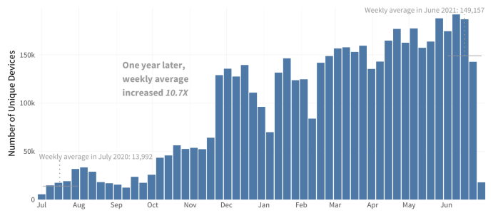
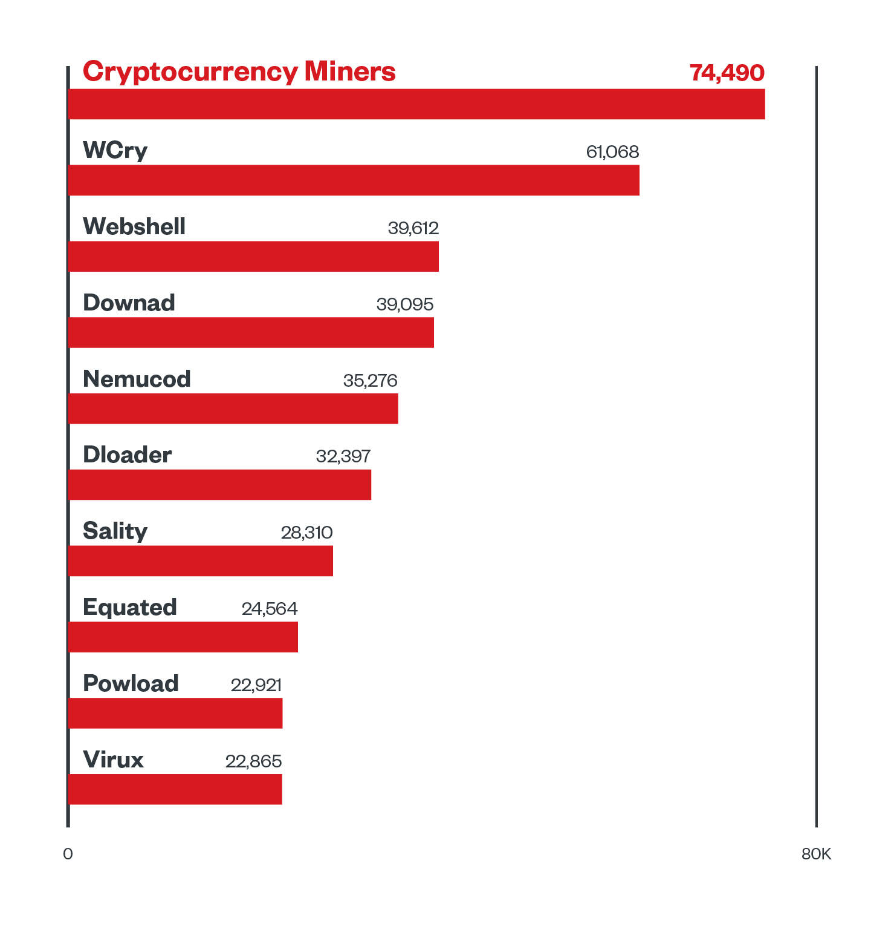
Ransomware takes the stage
Ransomware volume in last 12 months
10.7x increase
https://www.fortinet.com/content/dam/fortinet/assets/threat-reports/report-threat-landscape-2021.pdf
Mandiant experts have reported that there were twice as many ransomware-involved investigations in 2020 than 2019.
“Multifaceted extortion and ransomware are the most prevalent threats to organizations. In this year’s report, direct financial gain was the likely motive for at least 36% of the intrusions we investigated.
https://vision.fireeye.com/editions/11/11-m-trends.html#
https://www.trendmicro.com/en_us/research/21/i/midyear-2021-cybersecurity-landscape-review.html

Slide 7
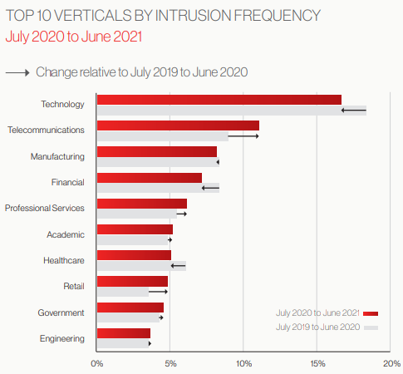
New Patters
A TROUBLING TREND
TARGETS
Crowdstrike: “OverWatch has tracked a 60% increase in interactive intrusion activity in the past year… of all of the detections indexed by CrowdStrike Threat Graph® in the past three months, 68% were malware-free.”
FireEye top MITRE TTPs
Ref: FireEye mtrends 2021
https://go.crowdstrike.com/rs/281-OBQ-266/images/Report2021ThreatHunting.pdf
Notes:
The professional services industry saw a more than 90% increase in interactive intrusion numbers, while the government and academic sectors both saw intrusion numbers increase by more than 80%

Slide 8
THE RESPONSE

Slide 9
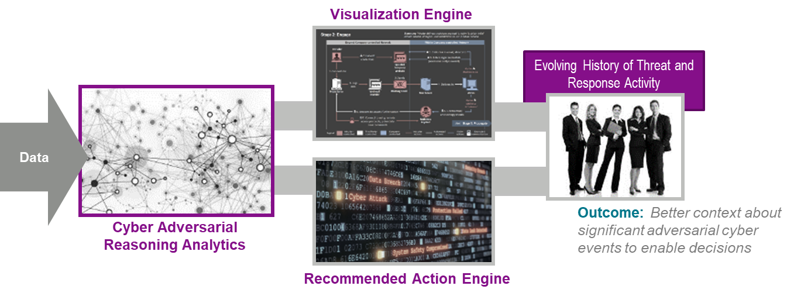
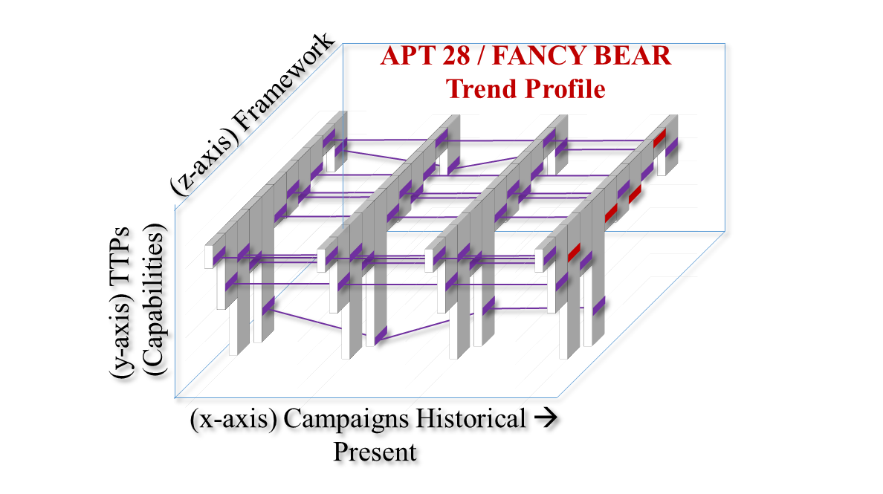
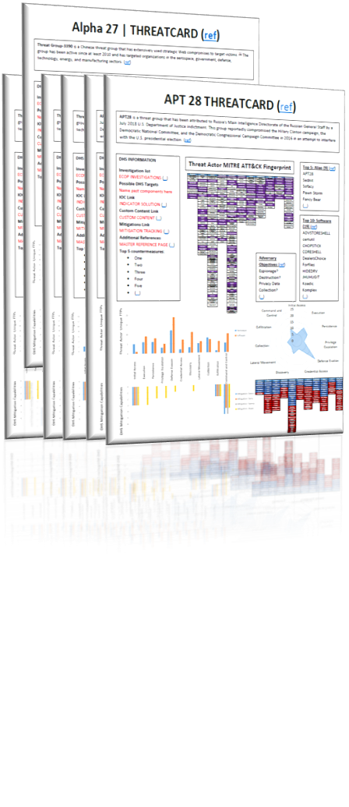
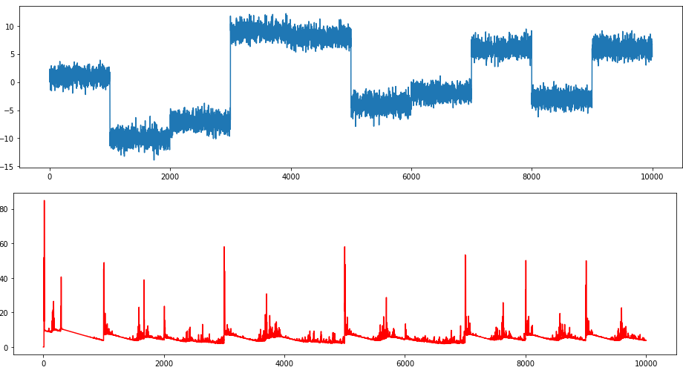
Four Areas of Defense
1
2
3
4
Cyber AI/ML: Utilizing AI and Machine learning to find user behavior anomalies, create animated personas, and identifies ways to simultaneously developing tools for defense and offense capabilities (Subversion, Deception, Statistical Deviations).
AI Guided Threat Cards: aims to use cyber threat packages based on real threat TTPs coupled with AI/ML models against actual data to detect and respond to the TTPs the selected actor would leave behind in a real environment.
CRUSADER: (Cyber Range for Understanding SOC Adversarial Defense and Emergency Response) Scalable and customized Cyber Range to support teams of defenders analyzing simulated attacks and hunting for customized full kill chain range of attack behaviors.
CARD: (Cyber Adversarial Reasoning Analytics) Presents context around adversarial cyber activity to enable decision making in near-real time. A platform to make sense of numerous alerts, disconnected data from various sensors, and threat intelligence to characterize threats. Ability to automate query and pivot tasks normally performed by highly technical analysts.
Notes:
Cyber Operations -

Slide 10
Frameworks: What is still practical today
TACTICS (12)
Initial Access | Execution | Persistence | Privilege Escalation | Defense Evasion | Credential Access | Discovery | Lateral Movement | Collection | C2 | Exfiltration | Impact
Initial Access | Execution | Persistence | Privilege Escalation | Defense Evasion | Credential Access | Discovery | Lateral Movement | Collection | Exfiltration | Command and Control
Drive-by Compromise | AppleScript | .bash_profile and .bashrc | Access Token Manipulation | Access Token Manipulation | Account Manipulation | Account Discovery | AppleScript | Audio Capture | Automated Exfiltration | Commonly Used Port
Exploit Public-Facing Application | CMSTP | Accessibility Features | Accessibility Features | BITS Jobs | Bash History | Application Window Discovery | Application Deployment Software | Automated Collection | Data Compressed | Communication Through Removable Media
Hardware Additions | Command-Line Interface | Account Manipulation | AppCert DLLs | Binary Padding | Brute Force | Browser Bookmark Discovery | Distributed Component Object Model | Clipboard Data | Data Encrypted | Connection Proxy
Replication Through Removable Media | Compiled HTML File | AppCert DLLs | AppInit DLLs | Bypass User Account Control | Credential Dumping | File and Directory Discovery | Exploitation of Remote Services | Data Staged | Data Transfer Size Limits | Custom Command and Control Protocol
Spearphishing Attachment | Control Panel Items | AppInit DLLs | Application Shimming | CMSTP | Credentials in Files | Network Service Scanning | Logon Scripts | Data from Information Repositories | Exfiltration Over Alternative Protocol | Custom Cryptographic Protocol
Spearphishing Link | Dynamic Data Exchange | Application Shimming | Bypass User Account Control | Clear Command History | Credentials in Registry | Network Share Discovery | Pass the Hash | Data from Local System | Exfiltration Over Command and Control Channel | Data Encoding
Spearphishing via Service | Execution through API | Authentication Package | DLL Search Order Hijacking | Code Signing | Exploitation for Credential Access | Network Sniffing | Pass the Ticket | Data from Network Shared Drive | Exfiltration Over Other Network Medium | Data Obfuscation
Supply Chain Compromise | Execution through Module Load | BITS Jobs | Dylib Hijacking | Compiled HTML File | Forced Authentication | Password Policy Discovery | Remote Desktop Protocol | Data from Removable Media | Exfiltration Over Physical Medium | Domain Fronting
Trusted Relationship | Exploitation for Client Execution | Bootkit | Exploitation for Privilege Escalation | Component Firmware | Hooking | Peripheral Device Discovery | Remote File Copy | Email Collection | Scheduled Transfer | Fallback Channels
Valid Accounts | Graphical User Interface | Browser Extensions | Extra Window Memory Injection | Component Object Model Hijacking | Input Capture | Permission Groups Discovery | Remote Services | Input Capture |  | Multi-Stage Channels
 | InstallUtil | Change Default File Association | File System Permissions Weakness | Control Panel Items | Input Prompt | Process Discovery | Replication Through Removable Media | Man in the Browser |  | Multi-hop Proxy
 | LSASS Driver | Component Firmware | Hooking | DCShadow | Kerberoasting | Query Registry | SSH Hijacking | Screen Capture |  | Multiband Communication
 | Launchctl | Component Object Model Hijacking | Image File Execution Options Injection | DLL Search Order Hijacking | Keychain | Remote System Discovery | Shared Webroot | Video Capture |  | Multilayer Encryption
 | Local Job Scheduling | Create Account | Launch Daemon | DLL Side-Loading | LLMNR/NBT-NS Poisoning | Security Software Discovery | Taint Shared Content |  |  | Port Knocking
 | Mshta | DLL Search Order Hijacking | New Service | Deobfuscate/Decode Files or Information | Network Sniffing | System Information Discovery | Third-party Software |  |  | Remote Access Tools
 | PowerShell | Dylib Hijacking | Path Interception | Disabling Security Tools | Password Filter DLL | System Network Configuration Discovery | Windows Admin Shares |  |  | Remote File Copy
 | Regsvcs/Regasm | External Remote Services | Plist Modification | Exploitation for Defense Evasion | Private Keys | System Network Connections Discovery | Windows Remote Management |  |  | Standard Application Layer Protocol
 | Regsvr32 | File System Permissions Weakness | Port Monitors | Extra Window Memory Injection | Securityd Memory | System Owner/User Discovery |  |  |  | Standard Cryptographic Protocol
 | Rundll32 | Hidden Files and Directories | Process Injection | File Deletion | Two-Factor Authentication Interception | System Service Discovery |  |  |  | Standard Non-Application Layer Protocol
 | Scheduled Task | Hooking | SID-History Injection | File Permissions Modification |  | System Time Discovery |  |  |  | Uncommonly Used Port
 | Scripting | Hypervisor | Scheduled Task | File System Logical Offsets |  |  |  |  |  | Web Service
 | Service Execution | Image File Execution Options Injection | Service Registry Permissions Weakness | Gatekeeper Bypass
 | Signed Binary Proxy Execution | Kernel Modules and Extensions | Setuid and Setgid | HISTCONTROL
 | Signed Script Proxy Execution | LC_LOAD_DYLIB Addition | Startup Items | Hidden Files and Directories
 | Source | LSASS Driver | Sudo Caching | Hidden Users
 | Space after Filename | Launch Agent | Sudo | Hidden Window
 | Third-party Software | Launch Daemon | Valid Accounts | Image File Execution Options Injection
 | Trap | Launchctl | Web Shell | Indicator Blocking
 | Trusted Developer Utilities | Local Job Scheduling |  | Indicator Removal from Tools
 | User Execution | Login Item |  | Indicator Removal on Host
 | Windows Management Instrumentation | Logon Scripts |  | Indirect Command Execution
 | Windows Remote Management | Modify Existing Service |  | Install Root Certificate
 | XSL Script Processing | Netsh Helper DLL |  | InstallUtil
 |  | New Service |  | LC_MAIN Hijacking
 |  | Office Application Startup |  | Launchctl
 |  | Path Interception |  | Masquerading
 |  | Plist Modification |  | Modify Registry
 |  | Port Knocking |  | Mshta
 |  | Port Monitors |  | NTFS File Attributes
 |  | Rc.common |  | Network Share Connection Removal
 |  |  |  | Valid Accounts
 |  |  |  | Web Service
 |  |  |  | XSL Script Processing

Slide 11
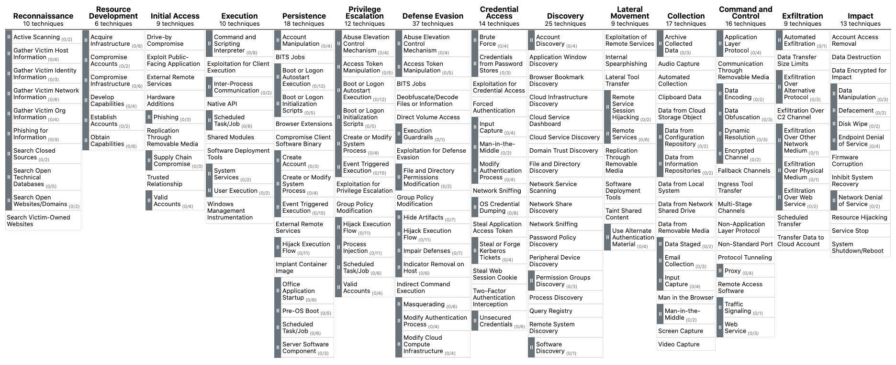
MITRE ATT&CK®

Slide 12
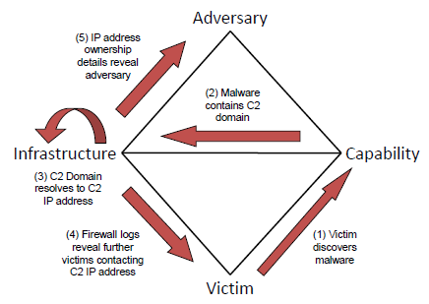
Threat Frameworks Continued…
Diamond Model
This framework takes a relationship approach between the adversary and the victim. Ultimately this framework is best suited to deduce “attribution” and “intent”
Ref: http://www.activeresponse.org/wp-content/uploads/2013/07/diamond.pdf
Ref: http://www.activeresponse.org/wp-content/uploads/2013/07/diamond_summary.pdf
Notes:
Utilize data and intelligence from all available sources and from every attack, successful or not, to better understand our adversaries, their patterns and behaviors over time driving to a proactive defensive and adaptive risk posture
Utilize industry standard frameworks to categorize, track, and measure our capabilities and methods

Slide 13
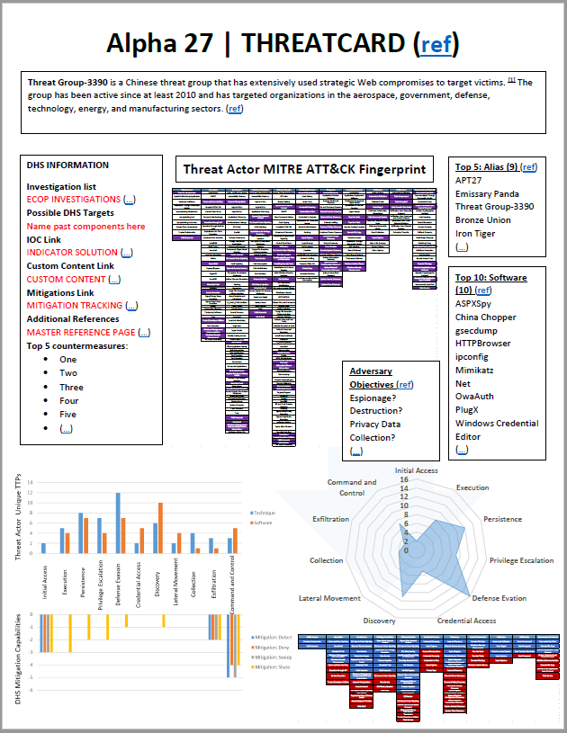
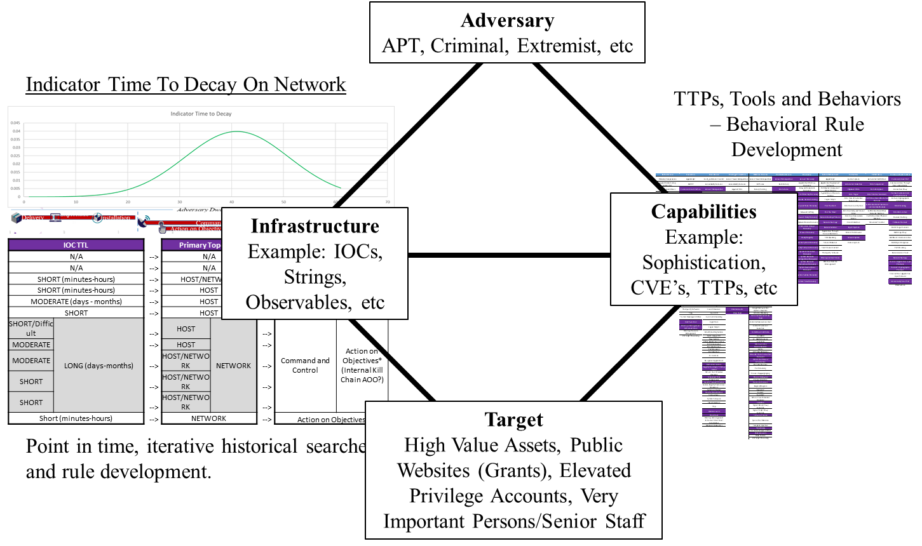
Framework needs to be Operationalized
1
1
2
3
1
4
5
2

Slide 14
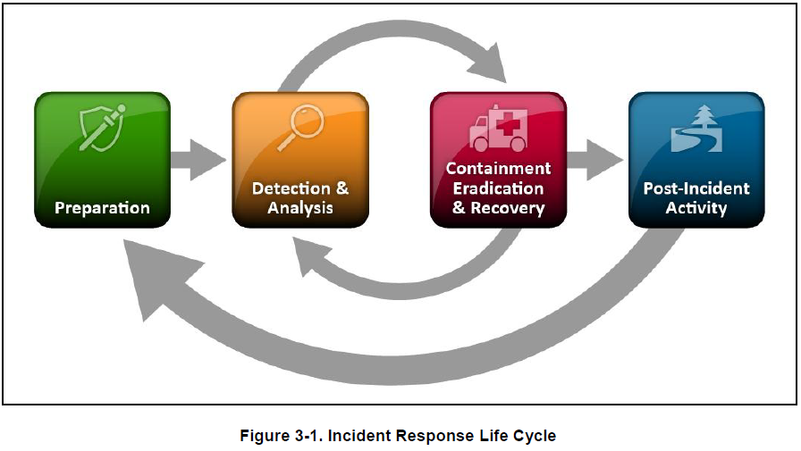
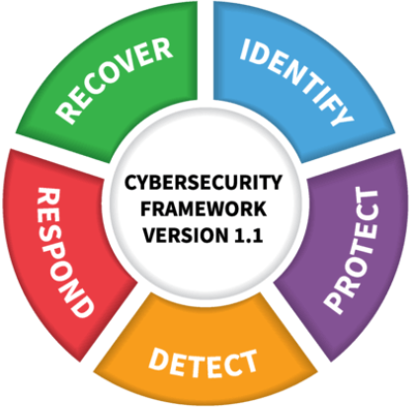
Incident Response Processes
NIST 800-61r2
Section 3. Handling an Incident
NIST
Cybersecurity Framework
Difference: Traditional industry recognized approach with an emphasis in “post identification” analysis, i.e. the Incident Response lifecycle. (identify and protect are typically “pre”)
Ref: https://nvlpubs.nist.gov/nistpubs/SpecialPublications/NIST.SP.800-61r2.pdf
Ref: https://www.nist.gov/news-events/news/2018/04/nist-releases-version-11-its-popular-cybersecurity-framework

Slide 15
Threat Modeling
Threat Intelligence and Decision Making
How to make smarter decisions
How Does Decision Making Fail?
Planning for what is scary instead of what is likely
Seat belts vs shark repellent
Priorities
Approaches
Prioritization framework
Vendor- and tool-agnostic
Free(ish)
Lack of clarity on what problems need to be solved
Cyber defense components working in silos

Slide 16
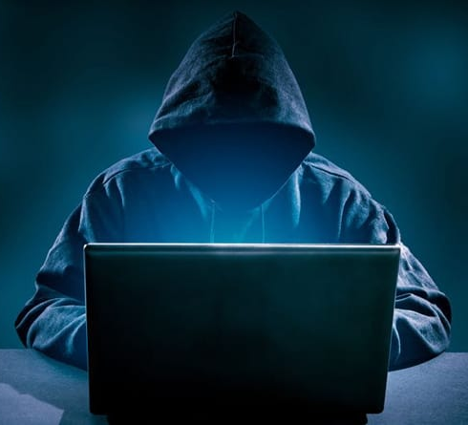
Threat Modeling Musts
Use threat modeling to understand what threats are most pertinent to your organization.
DO use threat modeling to ensure your defenses match your threats.
DON’T use threat modeling to publish neat reports nobody will read.

Slide 17
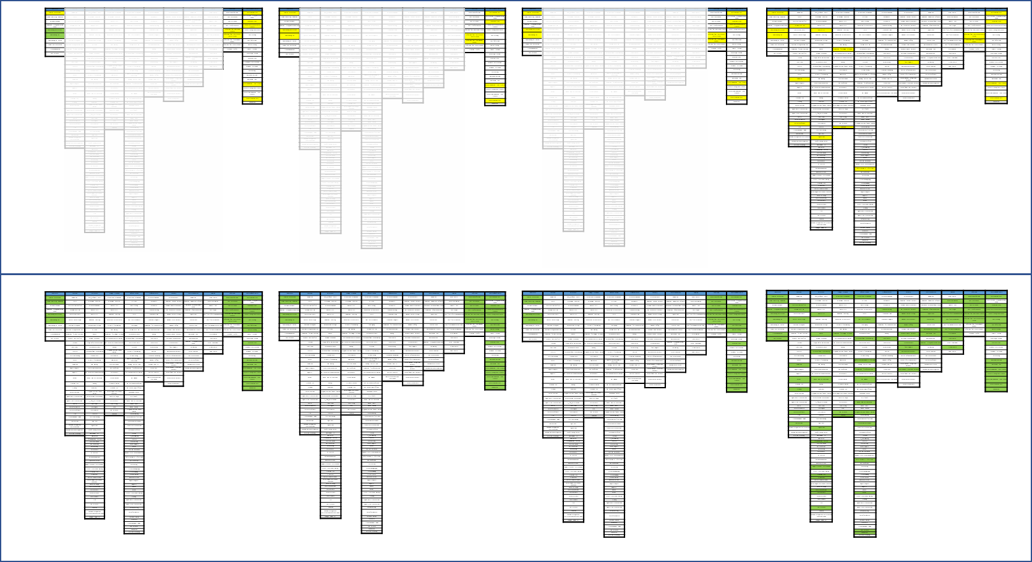
Threat Frameworks + Incident Response = Strategic Changes
Detect
Block
Sweep
Intelligence Sharing
Today
Tomorrow
250% Capability Increase
277% Capability Increase
250% Capability Increase
5x Enrichment of Intelligence Increase

Slide 18
Defining the Threat
Define the Target
What makes my organization worth targeting?
What do we actually do here?
How can someone make money off of my data?
What connections do I have to other targets?
Explore Historical Patterns
Explore Historical Targeting Patterns of Known Threats
Find a good source of potential threats: MITRE, ThaiCERT, paid threat intel feeds
Have any of these attackers targeted you?
Based on their reported past targeting, which of these actors are we most enticing to?
Build your own scorecard
Don’t get hung up on attribution
Get a decent sample size

Slide 19
Map Threat TTPs
Tactics, Techniques, and Procedures
Recent intelligence reports usually provide ATT&CK mappings
MITRE maintains a limited database of TTPs for both groups and malware
Threat intelligence vendors often maintain actor maps
What’s Common? What’s Exotic?
You want to detect and block every technique, but different levels of capabilities exist
Certain techniques are dramatically more common, others almost a non-issue
You may also want to prioritize certain tactics or actors
Alternatively, you may use some basis other than actor
This is a repeating process

Slide 20
THE EXAMPLE

Slide 21
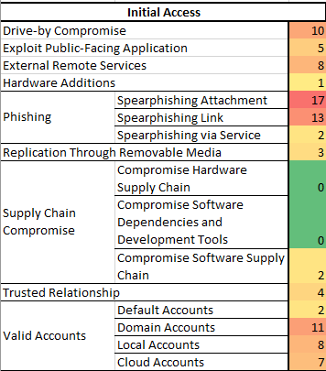
Let’s see an actual example
Example from USG Customers
Spear phishing is by far the most common Initial Access vector
Spear phishing via attachments is more common than spear phishing via link
Drive-by compromises, external remote services, valid accounts all fairly common
Hardware additions and hardware supply chain compromises are rarely observed in reporting
Software supply chain compromises and trusted relationships are uncommon but increasing in frequency
Some techniques may be common, just not among actors we care about
Seat belts vs shark repellent

Slide 22
Defense Auditing
Compare ATT&CK to Your Tools
~290 techniques in ATT&CK
Weed out the techniques that aren’t applicable to your environment
Use your threat heatmap to prioritize
If an Attacker Used This…
…would we have it logged?
…would a junior SOC analyst catch it at 3 AM on a Saturday night?
…would it be successful?
Gaps Analysis
Do you have visibility everywhere you need it?
Do you have your fundamentals covered?
Compare results to penetration tests

Slide 23
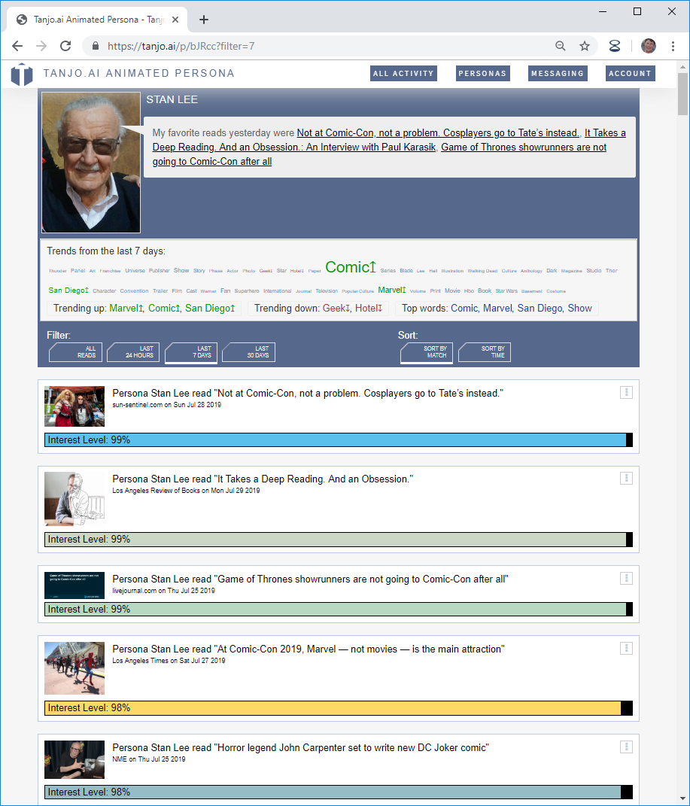
Modeling Insider Threats with AI
TAPchat
Ask your persona questions.
Type anything you like and get chat answers.
Or, just click [Ask] (or click into field) to show customizable pre-selected questions.
Knowledge, preferences, daily life, occasion profile, etc.
Ask the Stan Lee persona
Ask
TrendCloud
What is trending in this persona’s mind?
Word clouds, with a twist. Pick what time span to see trends over. Watch what ideas are growing (and shrinking) in mind-share the fastest.
Breakfast, grab-and-go. Drink coffee.
early-morning
LifeFeed
Watch your persona’s behavior.
What did they do today?
Watch them read media (and be influenced by it).
See their day brought to life.
Ask them about their life and preferences in TAPChat!
Date, romantic, movie
mid-morning
Snack, grab-and-go. Drink smoothie.
mid-afternoon
Drive to work
mid-afternoon
Work meeting. Snack, sit down. Drink soda.
late-afternoon
Gathering, at a home, indoors, celebration. Drink cocktail.
early-evening
Drive home
mid-evening

Slide 24
Orchestration & Automation Response
Ref: https://www.gartner.com/en/information-technology/glossary/security-orchestration-automation-response-soar

Slide 25
Call to action!
We need to begin thinking of use cases that are DCO than just traditional data analytics
The Cyber Challenge is not an IT Challenge. Don’t let IT be the only solution.
Have a Threat Centric Approach – be very intentional
AI/ML and Automation is NOT a silver bullet
Success requires an ability to measure the results of our actions

Slide 26
Questions?

Slide 27
Tactical Pattern and/or Anomaly
Recognition Search Examples

Slide 28
Tactical Searches for Anomalous Behavior
Beacon DNS monitoring:
sourcetype="XmlWinEventLog:Microsoft-Windows-Sysmon/Operational" EventCode=22 |streamstats current=f last(_time) as last_time by host,QueryName | eval gap=last_time - _time| stats count avg(gap) AS AverageBeaconTime var(gap) AS VarianceBeaconTime BY QueryName | eval AverageBeaconTime=round(AverageBeaconTime,3), VarianceBeaconTime=round(VarianceBeaconTime,3) | sort -count | where VarianceBeaconTime < 60 AND count > 2 AND AverageBeaconTime>1.000 |eval qLength=len(QueryName) | table QueryName,qLength, VarianceBeaconTime count AverageBeaconTime
Beaconing activity is also commonly found with DNS given the nature of how DNS works (making requests to domain name and translating that back to an IP address). The other side of DNS is that information can be passed allowing for Command and Control to occur, see DNS Tunneling.
Doing a variance and average upstream may not provide results that are expected since it is not observing what is actually happening on the host (which is ultimately what we are looking for). Looking for DNS from the asset using Sysmon, the variance here is different from the Firewall or Proxy. Rather than looking at the query between all traffic from SRC to DNS Queries, this statistic is based on the traffic specific to the queries themselves across all hosts. In this panel we recommend starting by looking at the qlength of DNS Queries over starting with the variance and average. Once a qlength and query appears malicious, then you would triage by looking for similar QueryNames from distinct hosts and check average and variance similar to Firewall Beacon OCONUS.
Notes:
Beaconing activity is also commonly found with DNS given the nature of how DNS works (making requests to domain name and translating that back to an IP address). The other side of DNS is that information can be passed allowing for Command and Control to occur, see DNS Tunneling.
DNS differs from Firewall in that DNS traffic when normal will first check your local cache first if the request has been made before, if it has not, then the standard next order would be to check the Domain Controller and then if not go up the chain of recursive DNS servers via zone transfers until it gets to the authoritative which then will go via internet and return back the IP address. The caching that is checked at each stage is important because if the query was already known or observed before, then it would not have to go back up the recursive chain and would simply return back the IP that it knows. Thus doing a variance and average upstream may not provide results that are expected since it is not observing what is actually happening on the host (which is ultimately what we are looking for). Also, for DNS beacon or tunneling may or may not always go up the chain. However, this is also only true if we are attempting standard web traffic and not thinking about hard coded DNS requests. For example, an NSLookup should always default not from your system but your standard DNS server to determine the right ip address.
When thought of this way, looking for DNS from the asset using Sysmon, the variance here is different from the Firewall or Proxy. Rather than looking at the query between all traffic from SRC to DNS Queries, this statistic is based on the traffic specific to the QUERIES themselves across all hosts. In this panel we recommend starting by looking at the qlength of DNS Queries over starting with the variance and average. Once a qlength and query appears malicious, then you would triage by looking for similar QueryNames from distinct hosts and check average and variance similar to Firewall Beacon OCONUS.

Slide 29
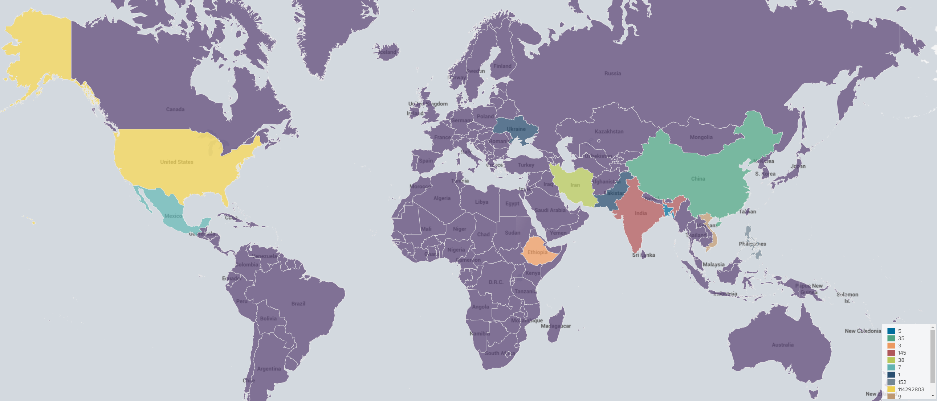
Tactical Searches for Anomalous Behavior
Remote Logon
sourcetype="WinEventLog:Security" EventCode=4624 Source_Network_Address=* Account_Name!="ANONYMOUS LOGON" AND Account_Name!="-" | iplocation Source_Network_Address | search Country!="United States"| stats count by Country, EventCode
Choropleth Map
sourcetype="WinEventLog:Security" EventCode=4624 Source_Network_Address=* | iplocation Source_Network_Address | stats count by Country| geom geo_countries allFeatures=True featureIdField=Country

Slide 30
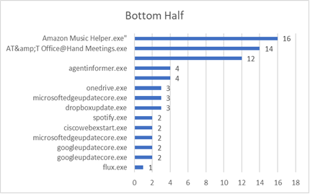
Tactical Searches for Anomalous Behavior
Periodic searches looking for bottom n statistics (long tail analysis) – Downloads/Temp
index=* sourcetype="WinEventLog:Security" OR sourcetype="WinHostMon" Process_Name=C:\\Users\\*.exe| eval Executable=split(Process_Name,"AppData") | eval executableCheck=mvindex(Executable,1) | stats count by executableCheck
index=* sourcetype="WinEventLog:Security" OR sourcetype="WinHostMon" Process_Name=C:\\Users\\*.exe| eval Executable=split(Process_Name,"Downloads") | eval executableCheck=mvindex(Executable,1) | stats count by executableCheck
Unexpected/Abnormal
Bottom Half Sampling [ Yellow = ____ _______ | Grey = Other Suspect Software ]
executableCheck | exe name | count
\Local\FluxSoftware\Flux\flux.exe" /noshow | flux.exe | 1
\Local\Dropbox\Update\DropboxUpdate.exe" /c | dropboxupdate.exe | 3
\Local\Microsoft\OneDrive\OneDrive.exe" /background | onedrive.exe | 3
\Local\Temp\Temp1_3.4.0.zip\_____ _____.exe | _____ _____.exe | 4
\Roaming\Movavi Video Suite 2020\AgentInformer.exe" | agentinformer.exe | 4
\Local\Temp\Temp2_MoveMouse_3.4.1.zip\\_____ _____.exe | _____ _____.exe | 12
\Local\Programs\officeathandmeetings\AT&amp;T Office@Hand Meetings.exe" startminimized | AT&amp;T Office@Hand Meetings.exe | 14

Slide 31
Tactical Searches for Anomalous Behavior
Failed logins based off unique accounts it attempted to login with (24h)
sourcetype="WinEventLog:Security" EventCode=4625 Source_Network_Address=* Source_Network_Address!="-" Source_Network_Address!="127.0.0.1" Source_Network_Address!="::1" Account_Name!="-" | stats values(Account_Name),dc(Account_Name) as UniqueAccounts,count by Source_Network_Address | sort -dc(Account_Name) | where UniqueAccounts>25
From the device "source_network_address" where X unqiue accounts that made XX failed attempts to authenticate to other devices. Source_Network_Address should be the IP that is originating the request to login the X accounts to see if a box is spraying attempts at credentials around the network.
Successful logins based off unique accounts logged in with (24h)
sourcetype="WinEventLog:Security" EventCode=4624 Source_Network_Address=* Source_Network_Address!="-" Source_Network_Address!="127.0.0.1" Source_Network_Address!="::1" Account_Name!="-" | stats values(Account_Name),dc(Account_Name) as UniqueAccounts,count by Source_Network_Address | sort -dc(Account_Name) | where UniqueAccounts>125
The panel here is looking to see how many successful distinct logins were made to each system. The challenge with this rule was that a threshold was set for >125 uniquely successful account names per system.

Slide 32
Tactical Searches for Anomalous Behavior
Register auto run monitoring
sourcetype="XmlWinEventLog:Microsoft-Windows-Sysmon/Operational" EventCode=13 TargetObject="*SOFTWARE\\Microsoft\\Windows\\CurrentVersion\\Run\\*" Image=C:\\Users\\* | eval Executable=split(registry_value_name,"AppData") | eval executableCheck=mvindex(Executable,1) | stats count by executableCheck
One method of persistence by malware is to create a beacon during startup. This is a method f persistence whereby when adding a program in the run keys in registry will execute the application when they log into the system. This method according to MITRE is called “Boot or Logon Autostart Execution: Registry Run Keys / Startup Folder” (Boot or Logon Autostart Execution: Registry Run Keys / Startup Folder, Sub-technique T1547.001 - Enterprise | MITRE ATT&CK®).
Although this search query looks within currentversion\run there are several other directories that should equally be looked at periodically which are listed below. Addtionally it should be noted that this query is looking for items specifically in the Users AppData directory. Similarly, we recommend searching AppData, Downloads, Desktop, Temp. The best way to ensure you have the right directories is to keep informed on malware families, exploit kits, new threat behaviors from APT actors and their tools, but also a general understanding of windows system (paths and operations could change).
Reference on Run and RunOnce: Run and RunOnce Registry Keys - Win32 apps | Microsoft Docs

Slide 33
Tactical Searches for Anomalous Behavior
Firewall beacon OCONUS:
sourcetype=“FIREWALL" |streamstats current=f last(_time) as last_time by src_ip,dest_ip,dest_port | eval gap=last_time - _time| stats count avg(gap) AS AverageBeaconTime var(gap) AS VarianceBeaconTime BY src_ip,dest_ip,dest_port | eval AverageBeaconTime=round(AverageBeaconTime,3), VarianceBeaconTime=round(VarianceBeaconTime,3) | sort -count | where count > 2 AND AverageBeaconTime>1.000 | iplocation dest_ip |search Country!="United States" | table src_ip,dest_ip,dest_port, Country, VarianceBeaconTime count AverageBeaconTime
Beaconing can occur at different rates and conditions which are typically scripted. This means that beaconing activity can occur on a time, when bootup as part of a process, when certain activities are done on the system, etc. This rule provides statistics which is gives information as to the Average Beacon Time (AverageBeaconTime) or the average time between each subsequent request from each asset. Then statistically what the variances the average time is from the norm of it’s own traffic. For example, an AverageBeaconTime value of “60” seconds with a VarianceBeaconTime of “0” would indicate that all requests from the SRC_IP to DST_IP happen within 60 seconds of each other. This would be a clear indication of a high potential scripted beaconing behavior to an ONOCUS IP address.
Additionally, since the statistics is derived from the distinct SRC_IP and DST_IP, we should also always look for where you have one SRC_IP and multiple DST_IPs of similar average beacon traffic with a low variance. This would be an example of a single IP that is doing beaconing behavior to multiple IPs which are OCONUS.

Slide 34
Tactical Searches for Anomalous Behavior
Exfil Watch: Beacon to None Category Domain:
sourcetype=“FIREWALL" category=none |streamstats current=f last(_time) as last_time by dest | eval gap=last_time - _time | stats count avg(gap) AS AverageBeaconTime var(gap) AS VarianceBeaconTime BY dest,category,c_ip | eval AverageBeaconTime=round(AverageBeaconTime,3), VarianceBeaconTime=round(VarianceBeaconTime,3) | sort -count | where VarianceBeaconTime < 3600 AND count > 20 AND AverageBeaconTime>30.000 AND AverageBeaconTime<91.000 | table c_ip, dest, category, VarianceBeaconTime, count, AverageBeaconTime
This rule is a combination of “No Category Domains” and “Firewall beacon OCONUS” looking for scripted and repeated beaconing traffic to categories of “none”. This rule could benefit in coverage from adding additional sources such as “malicious sources”, “malicious outbound data/botnets”, “blocklists”, etc.
sourcetype=“FIREWALL"
|streamstats current=f last(_time) as last_time by dest
| eval gap=last_time - _time
| stats count avg(gap) AS AverageBeaconTime var(gap) AS VarianceBeaconTime BY dest,category,c_ip
| eval AverageBeaconTime=round(AverageBeaconTime,3), VarianceBeaconTime=round(VarianceBeaconTime,3) | sort -count | where VarianceBeaconTime < 3600 AND count > 2 AND AverageBeaconTime>1.000 | table c_ip,dest,category VarianceBeaconTime count AverageBeaconTime

Slide 35
Tactical Searches for Anomalous Behavior
Phish: Winword / Outlook / EXCEL calling cmd or powershell (4h)
index=* sourcetype="WinEventLog:Security" OR sourcetype="WinHostMon" Creator_Process_Name="C:\\Program Files\\Microsoft Office\\root\\Office16\\OUTLOOK.EXE" OR Creator_Process_Name="C:\\Program Files\\Microsoft Office\\root\\Office16\\WINWORD.EXE" OR Creator_Process_Name="C:\\Program Files\\Microsoft Office\\root\\Office16\\EXCEL.EXE" (Process_Command_Line=*cmd.exe* OR Process_Command_Line=*powershell.exe*) AND Process_Command_Line!="C:\\WINDOWS\\system32\\cmd.exe /c \"\"\\*" | stats count by Creator_Process_Name,Process_Command_Line
Original process parent and child path of office.doc → cmd → PS to include a new evasion technique.
“the Emotet VBA Macro is using a WMI (windows management instrumentation) call to launch the subsequent attack code. For such WMI invocation via the Win32 Process class, the parent process of "cmd" ends up being WmiPrvSe.exe, which in turn is launched from "svchost". Therefore, "cmd" is not a child process of Word”
https://isc.sans.edu/forums/diary/Emotet+vs+Windows+Attack+Surface+Reduction/27036/
Powershell download commandlets (24h)
sourcetype="WinEventLog:Microsoft-Windows-PowerShell/Operational" Message!="*Author=\"Microsoft Corporation\"*" AND (downloadstring OR WebClient OR WebRequest OR BitsTransfer) Path!="C:\\ProgramData\\Amazon\\*" Path!="C:\\WINDOWS\\ccmcache\*" | table Message
https://isc.sans.edu/forums/diary/Maldoc+Analysis+With+CyberChef/26968/

